Slide 1
Erasmus+ Austria 2021
Daniel Karbus

Slide 2
Overview
Klagenfurt
Education (University, seminars)
My trips
Why to go

Slide 3
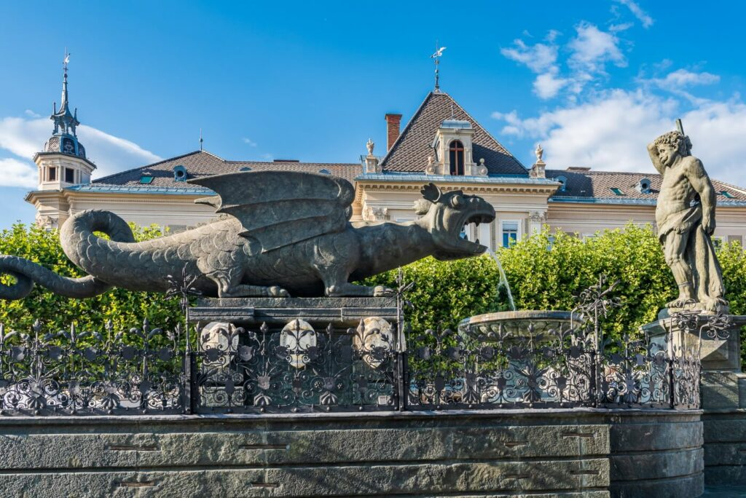
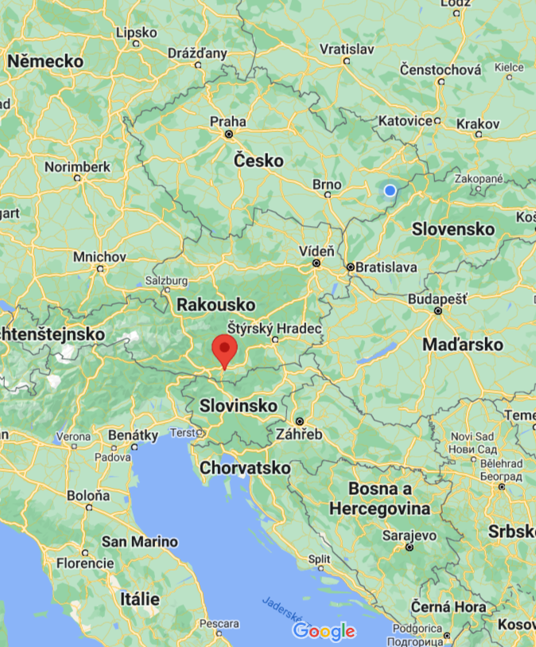
Klagenfurt am Wörthersee
It is the sixth-largest city in Austria

Slide 4
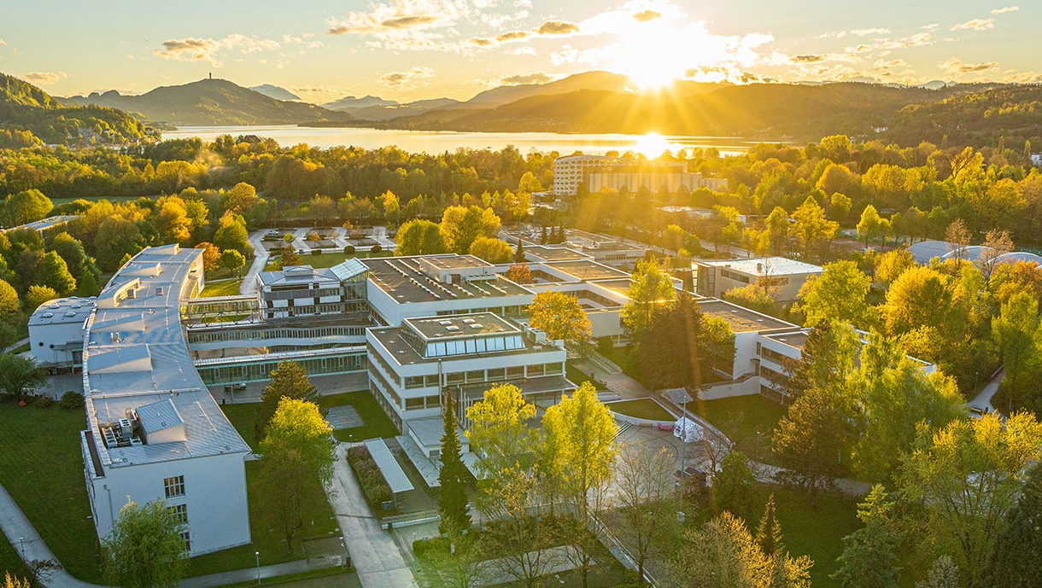
Alpen-Adria Universitat
A federal Austrian research university and the largest research and higher education institution in the state of Carinthia.

Slide 5
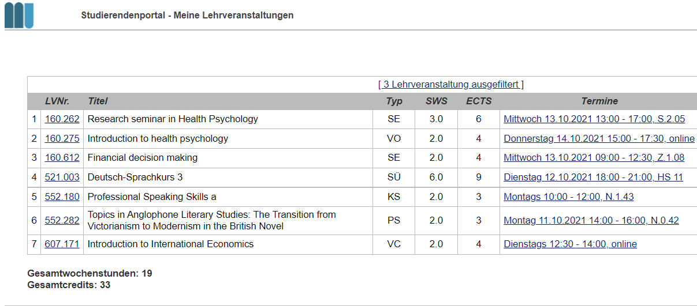
My seminars

Slide 6
My trips

Slide 7
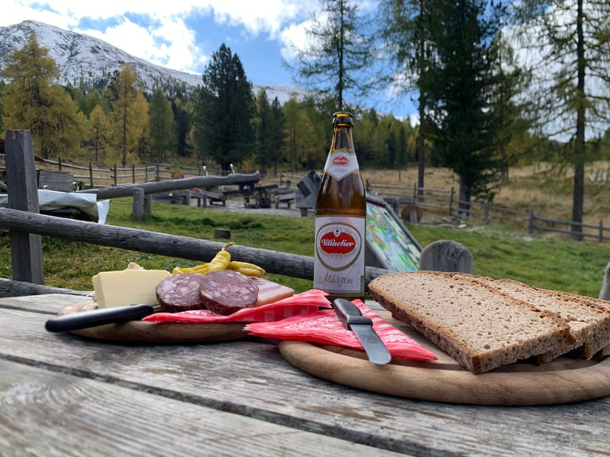
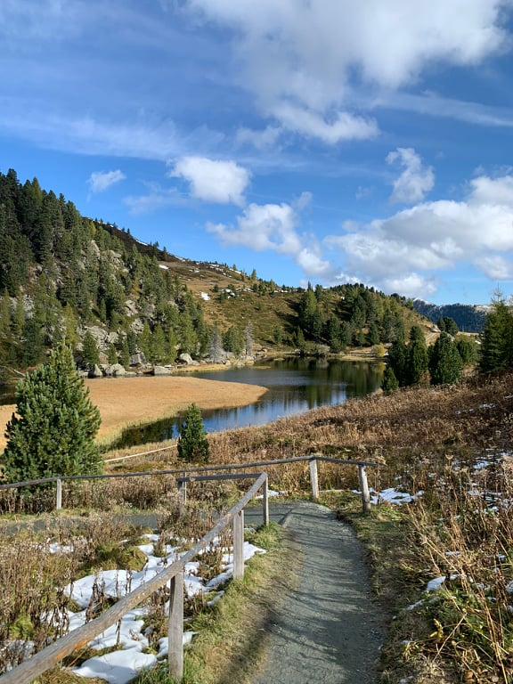
Nockalmstraße
Gentle mountain road with numerous attractions for all ages

Slide 8
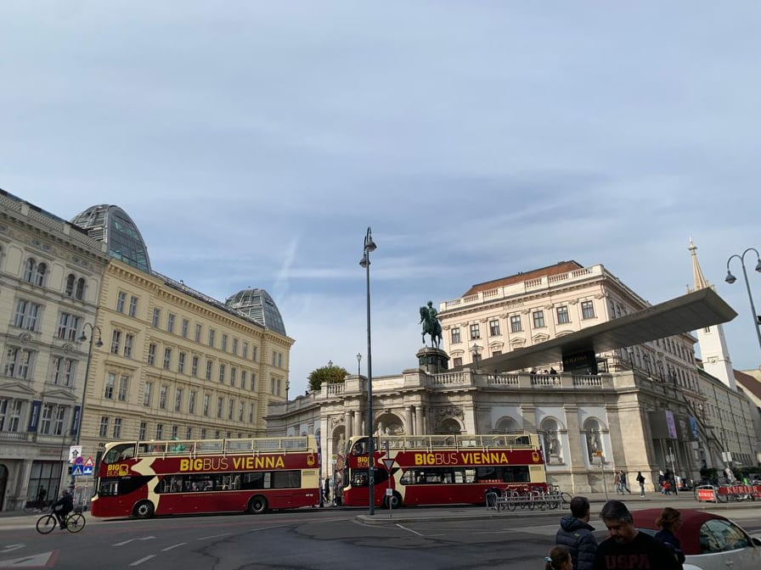
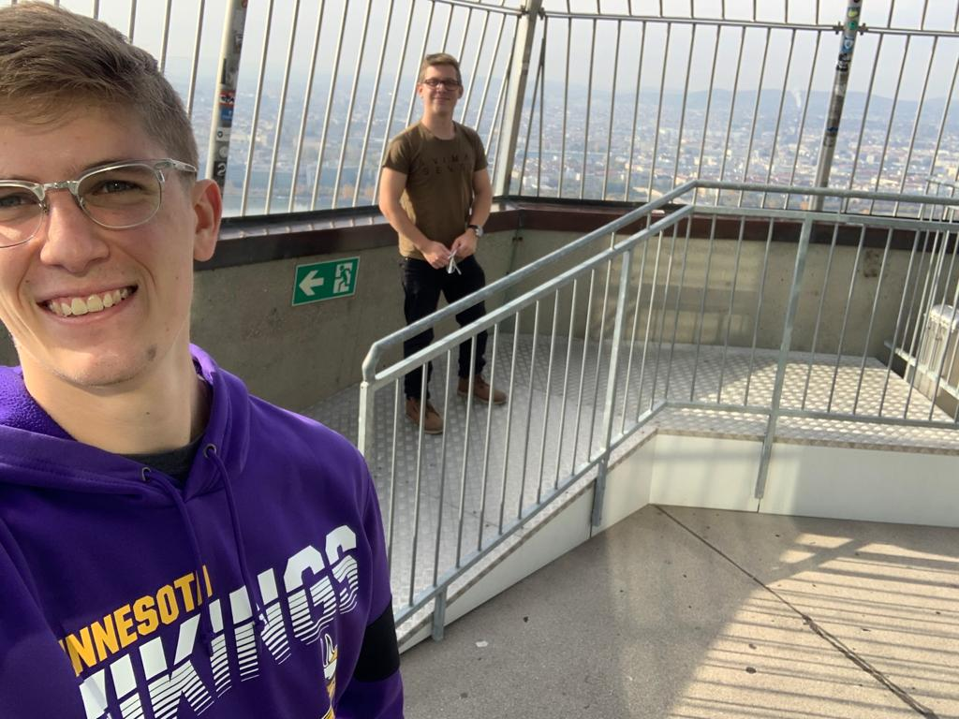
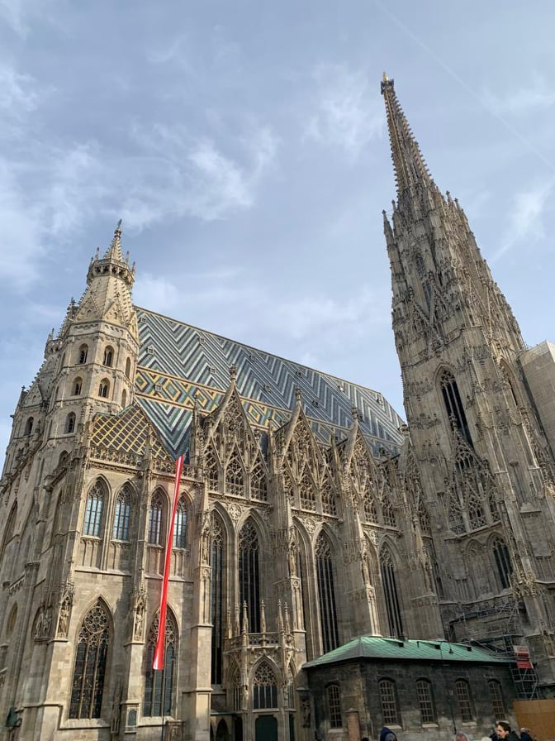
Vienna
the capital of Austria

Slide 9
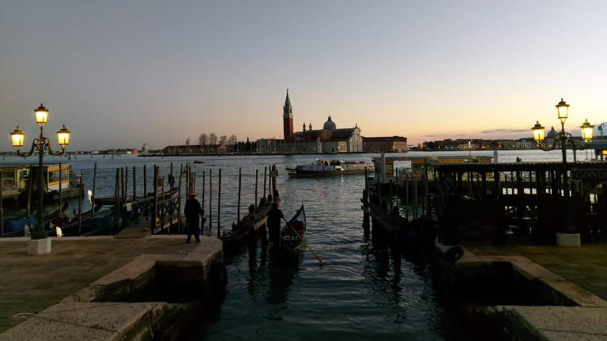
Venice
A place, I have always wanted to visit

Slide 10
Why would I recommend to go?
Experience
Meeting a new people who can become your friends
Language improvement
Personal development

Slide 11
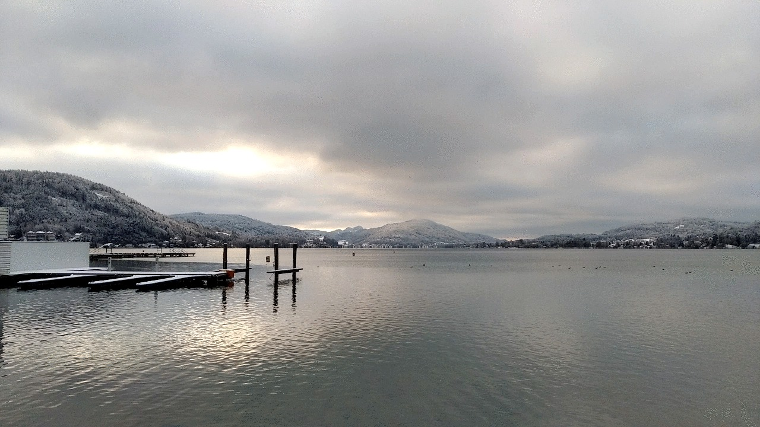
Thank you for your attention!

