Slide 1
My erasmus experiences
Denisa Stavinohová

Slide 2
What my erasmus gave me?
My boyfriend
New friends from around the world
Better english
Greater confidence
Known new places/explored new countries
Pushed me to be more brave
Absolutely love to travel
The best semesters of my study!
One of the best time of my life!

Slide 3
Erasmus in Slovenia

Slide 4
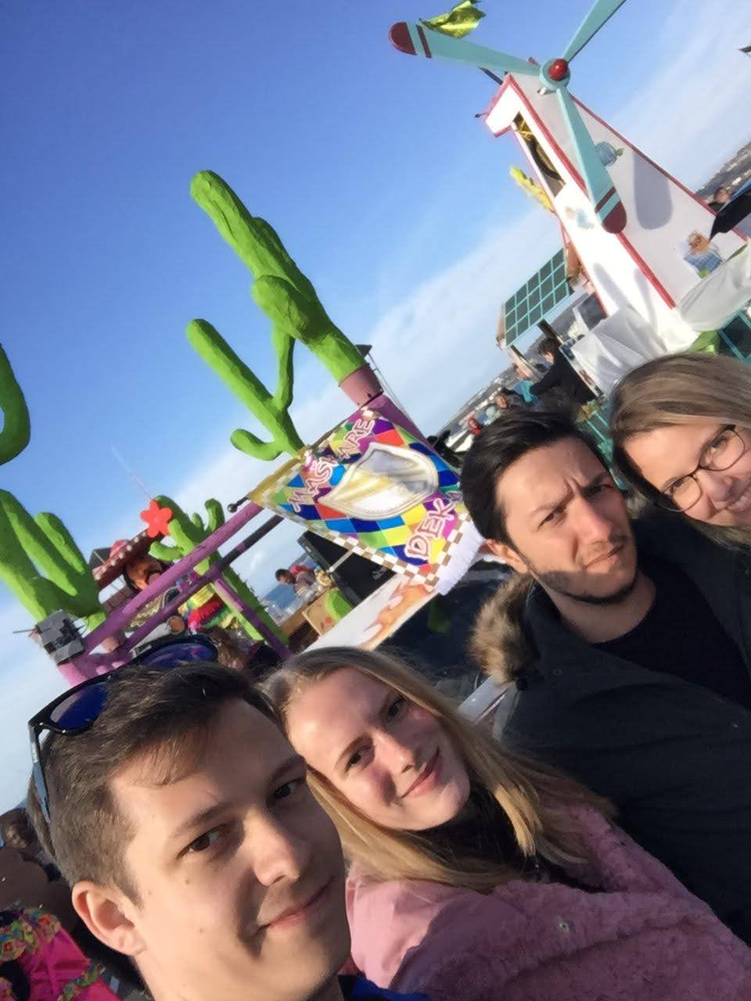
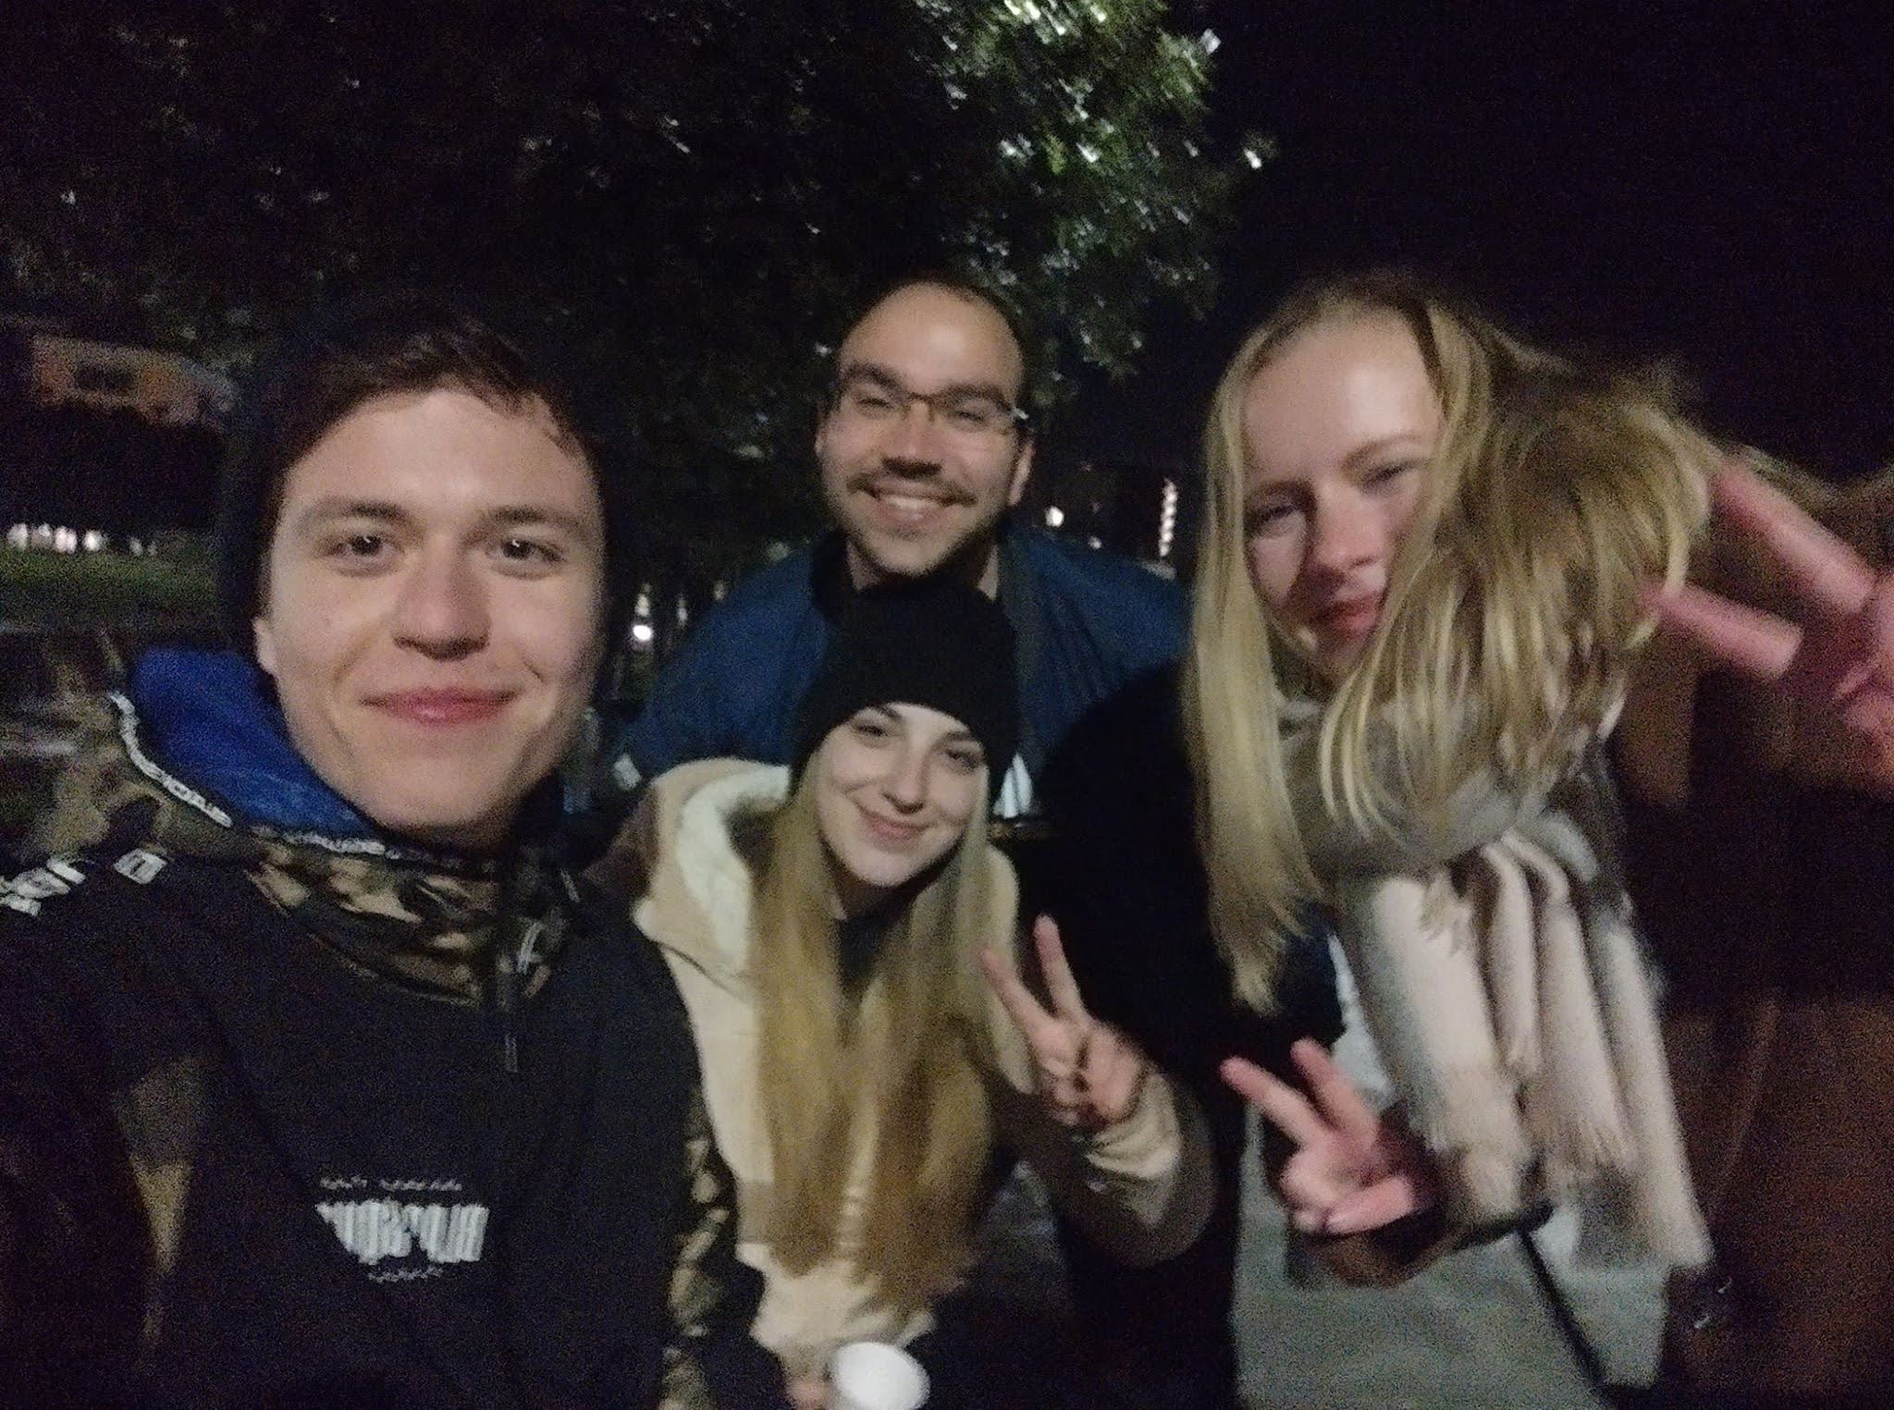
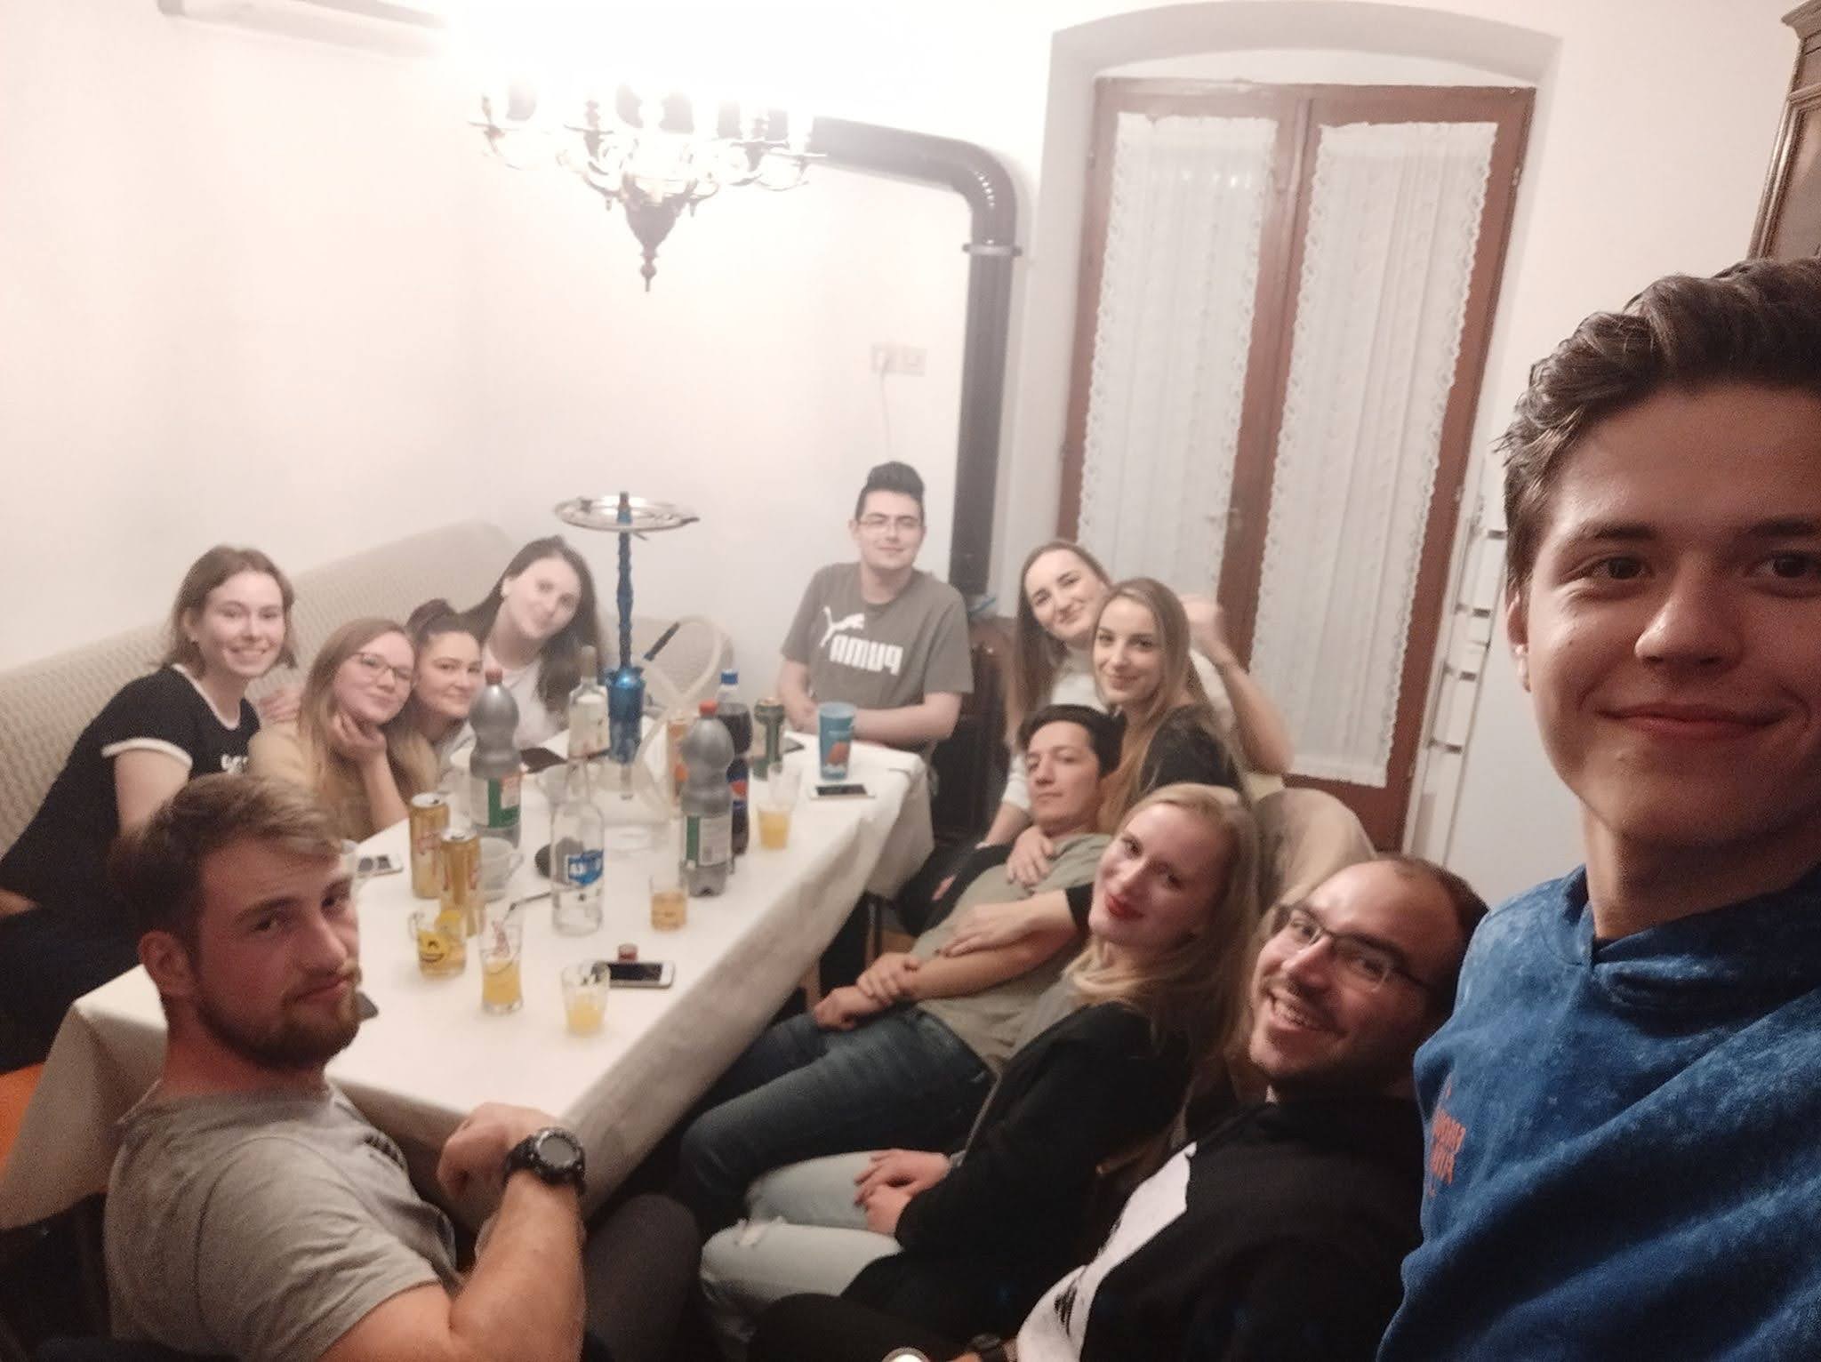
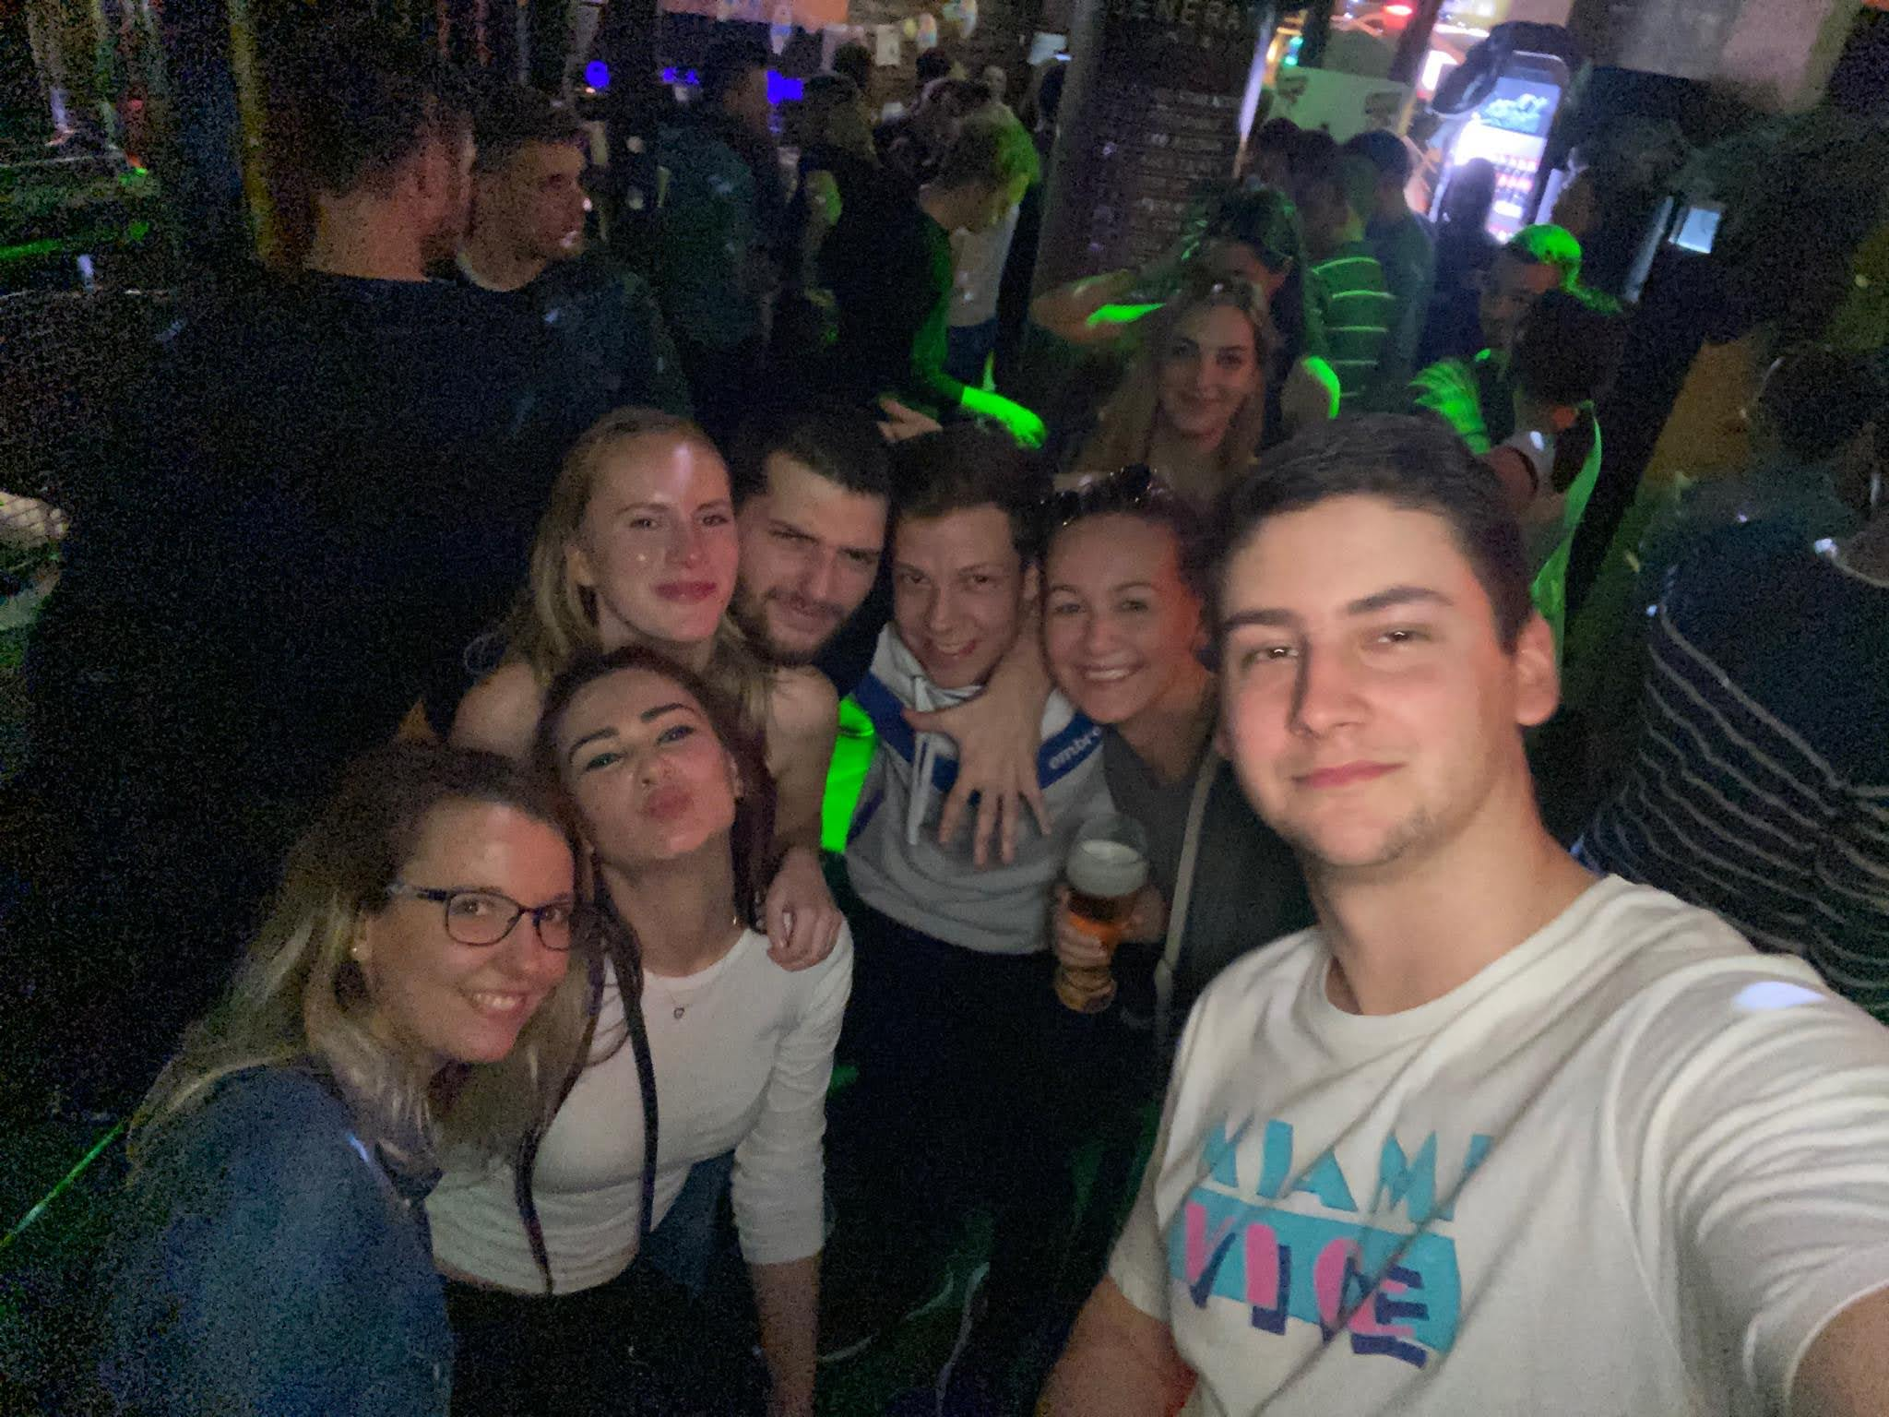
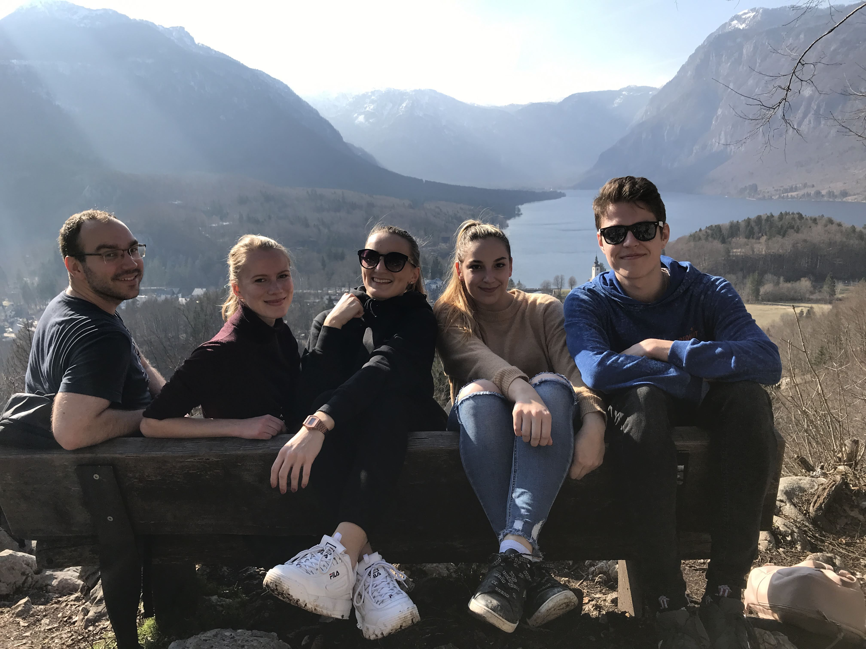
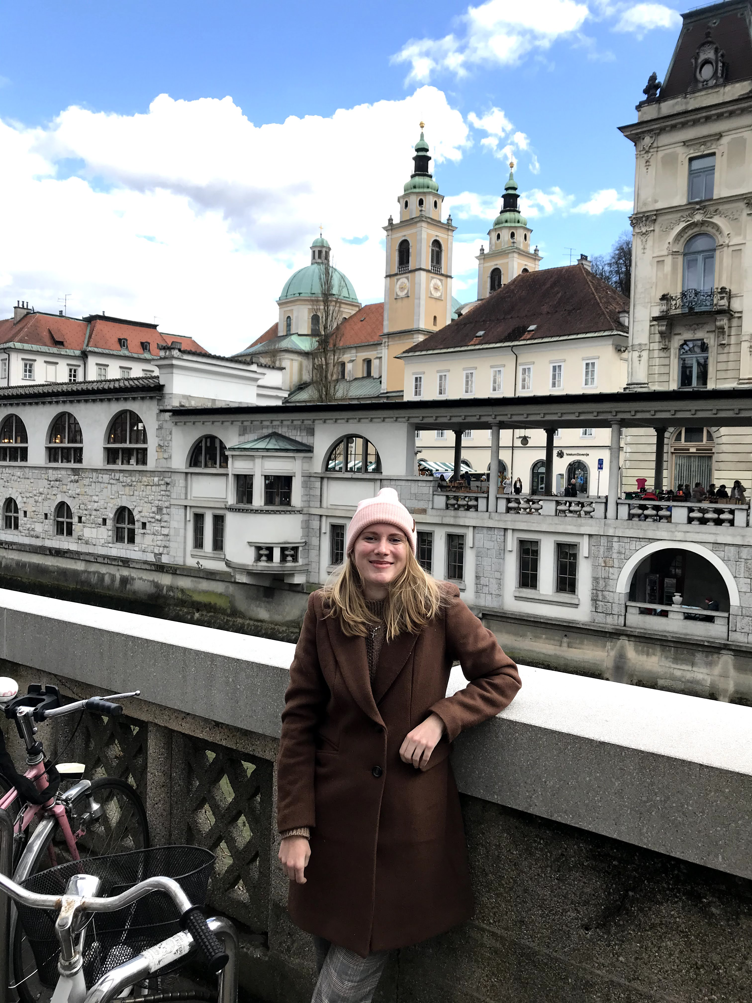

Slide 5
Erasmus in Poland

Slide 6
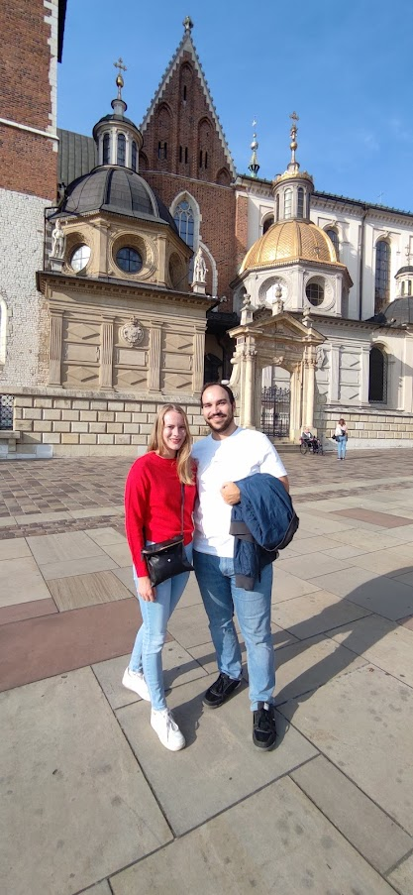
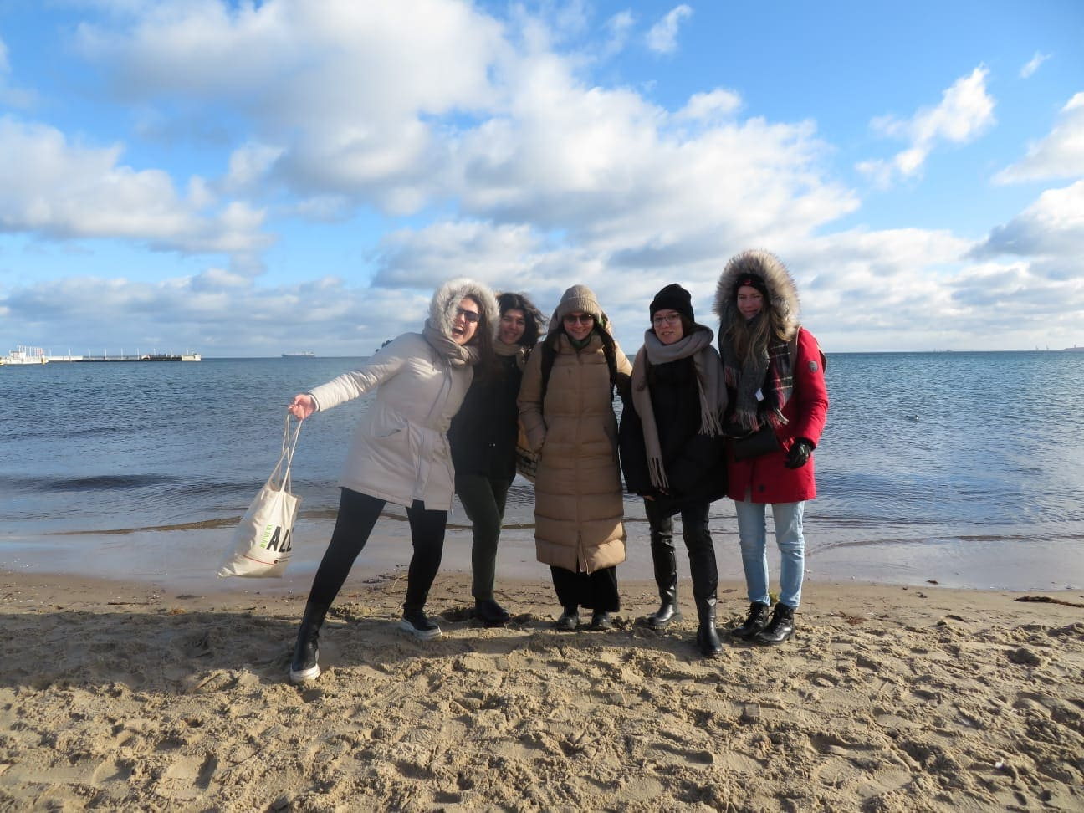
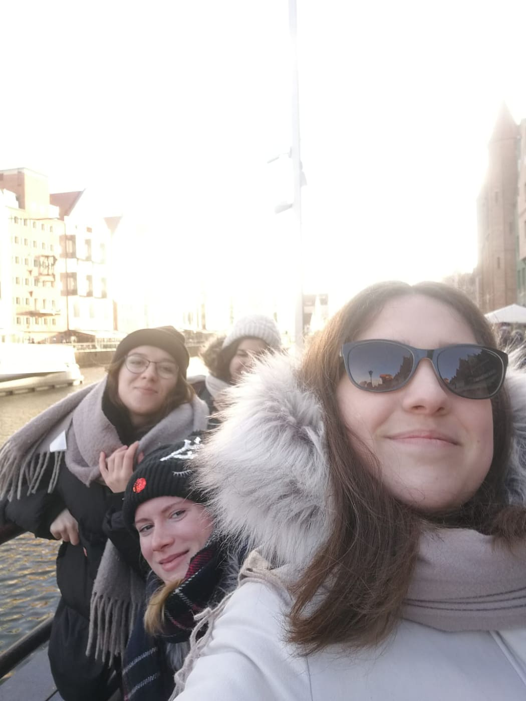
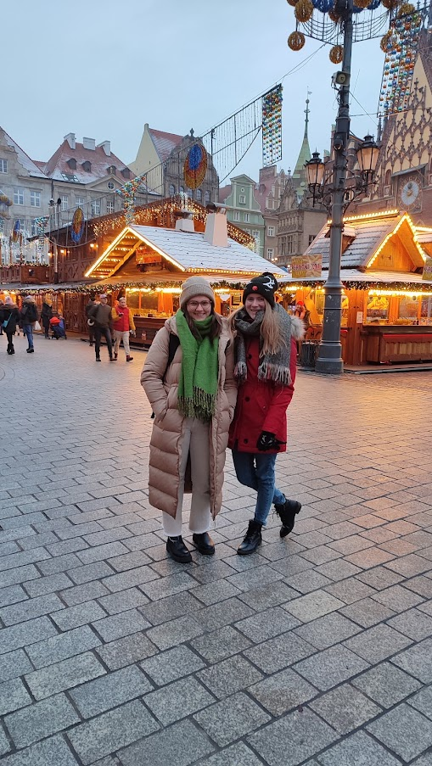
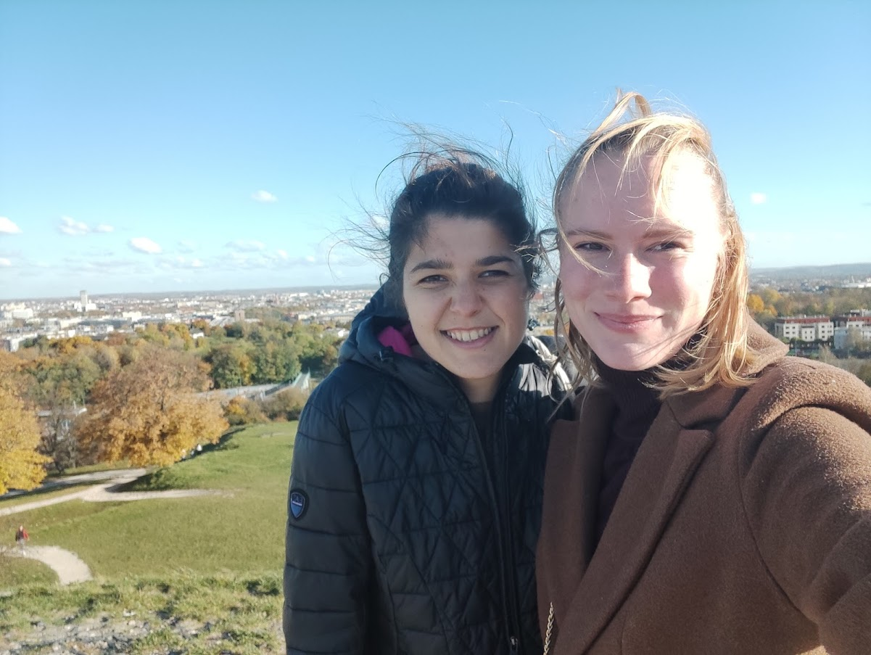
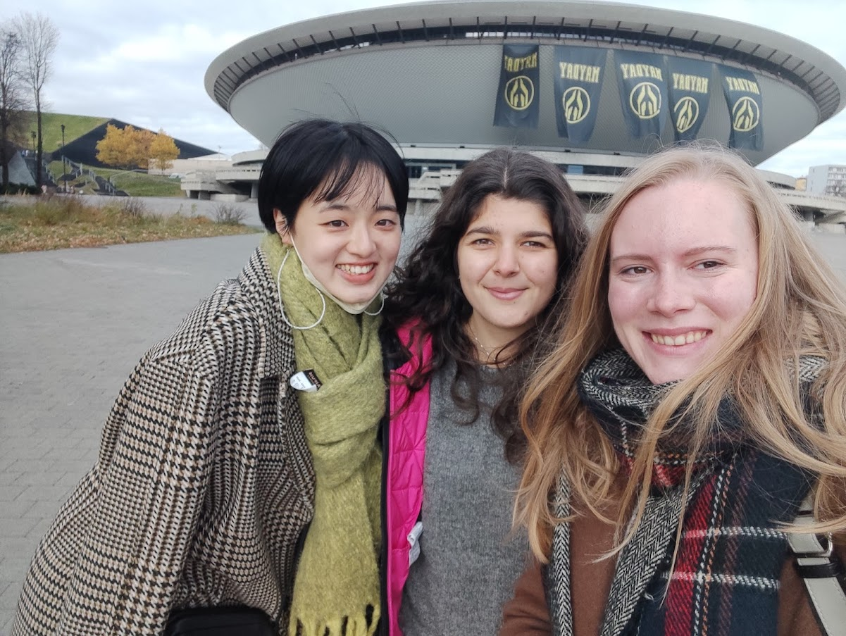

Slide 7
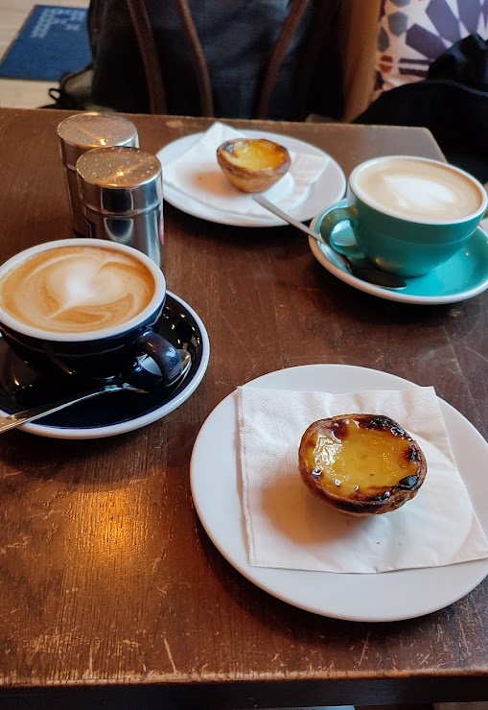
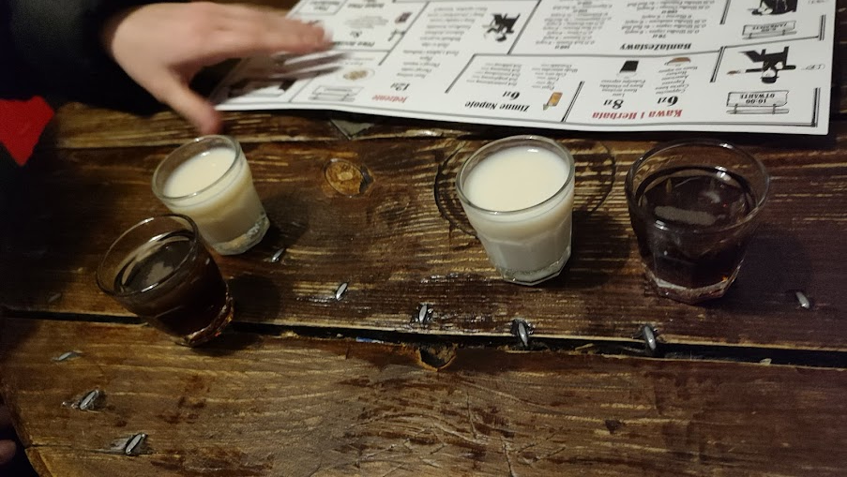
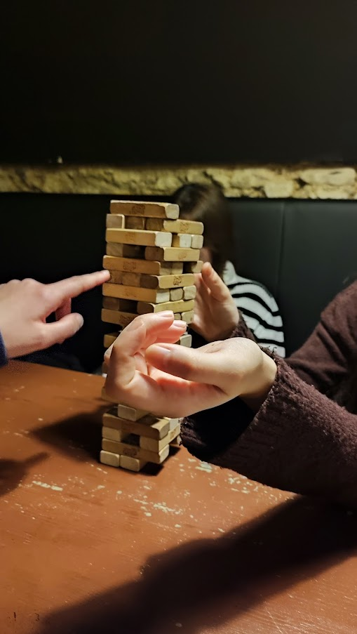
Krakow
Student city – first time when I lived long time in the city
Libraries, internet cafe – for study
Bars, board game bars, cafes, museums, galleries, jazz clubs, parks,
monumets
hockey, football
Jewish part of city - Kazimierz

Slide 8
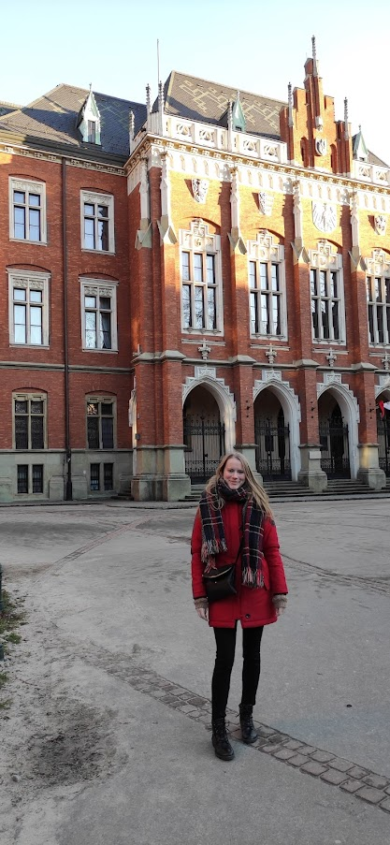
Jagiellonian university in Krakow
The oldest univerzity in europe
1.10.2021 – 24.2.2022
Almost full-time teaching
USOS web
International office

Slide 9
Courses
Registration to the courses
Can choose the courses from all faculties
My courses/my schedule

Slide 10
Accomodation
Dormitories : around 120 eur
Room in a private flat: around 200 – 280 eur
I suggest start to look fot the accomodation soon

Slide 11
ESN – Erasmus student network
Orientation week
Trips
Parties

Slide 12
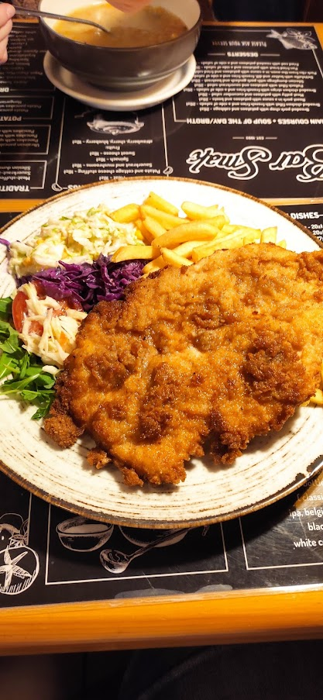
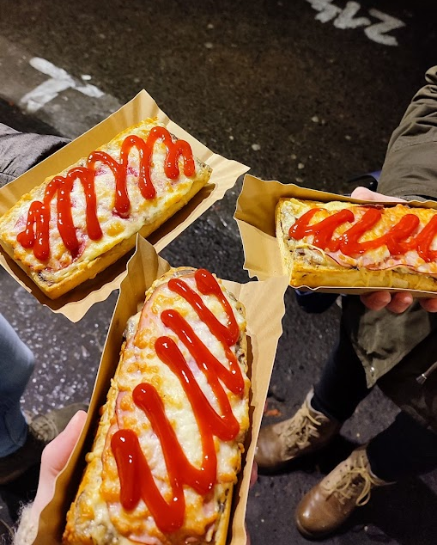
Food
Milky bar – like student canteen
Bar Smak, Chimera
Hamsa restaurant
Zapiekanky

Slide 13
Interesting places in Poland

Slide 14
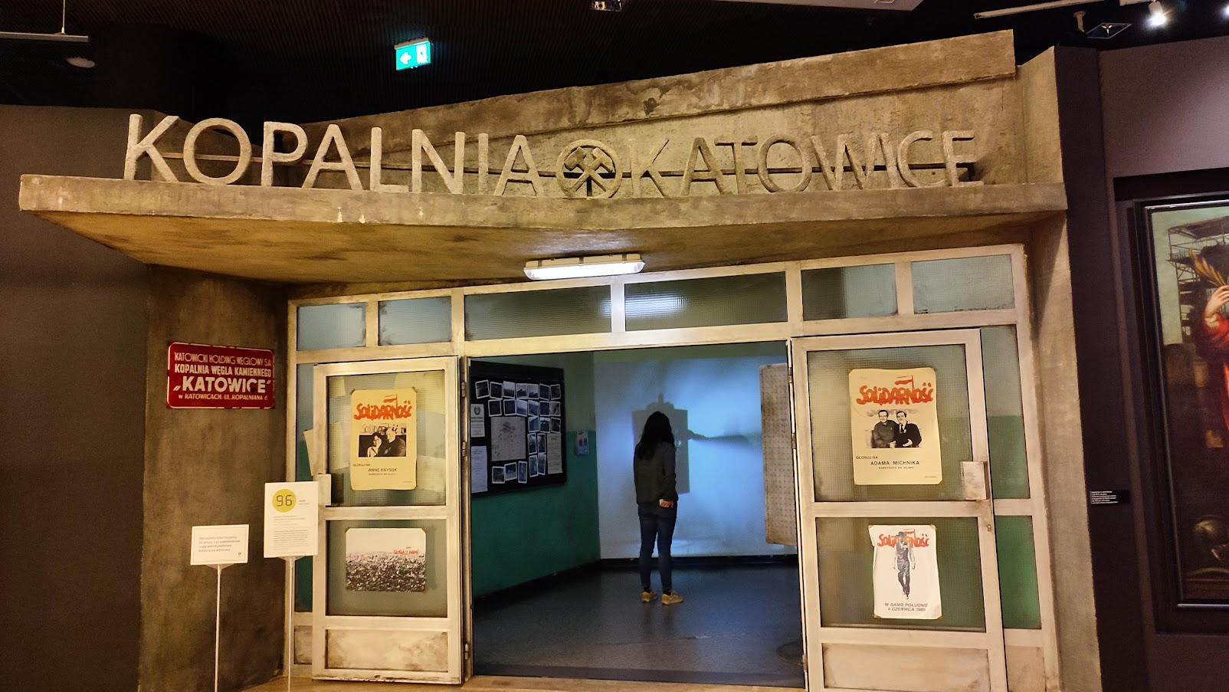
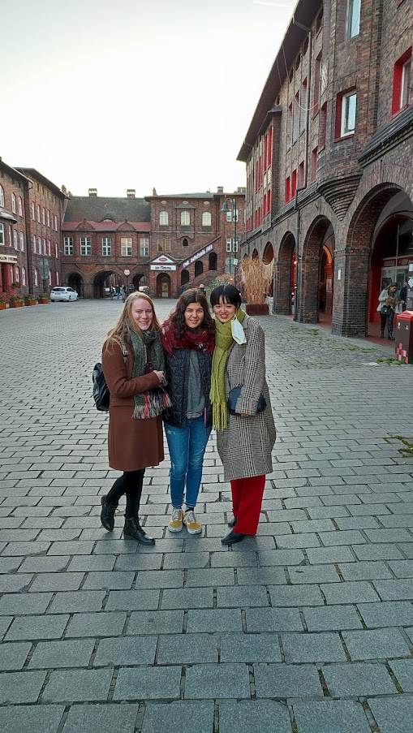
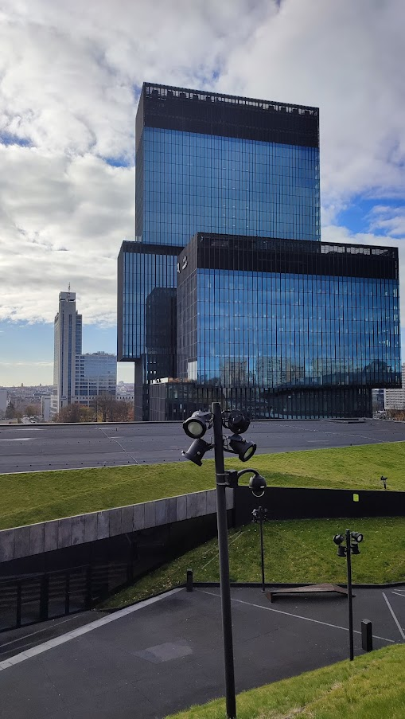
Katowice

Slide 15
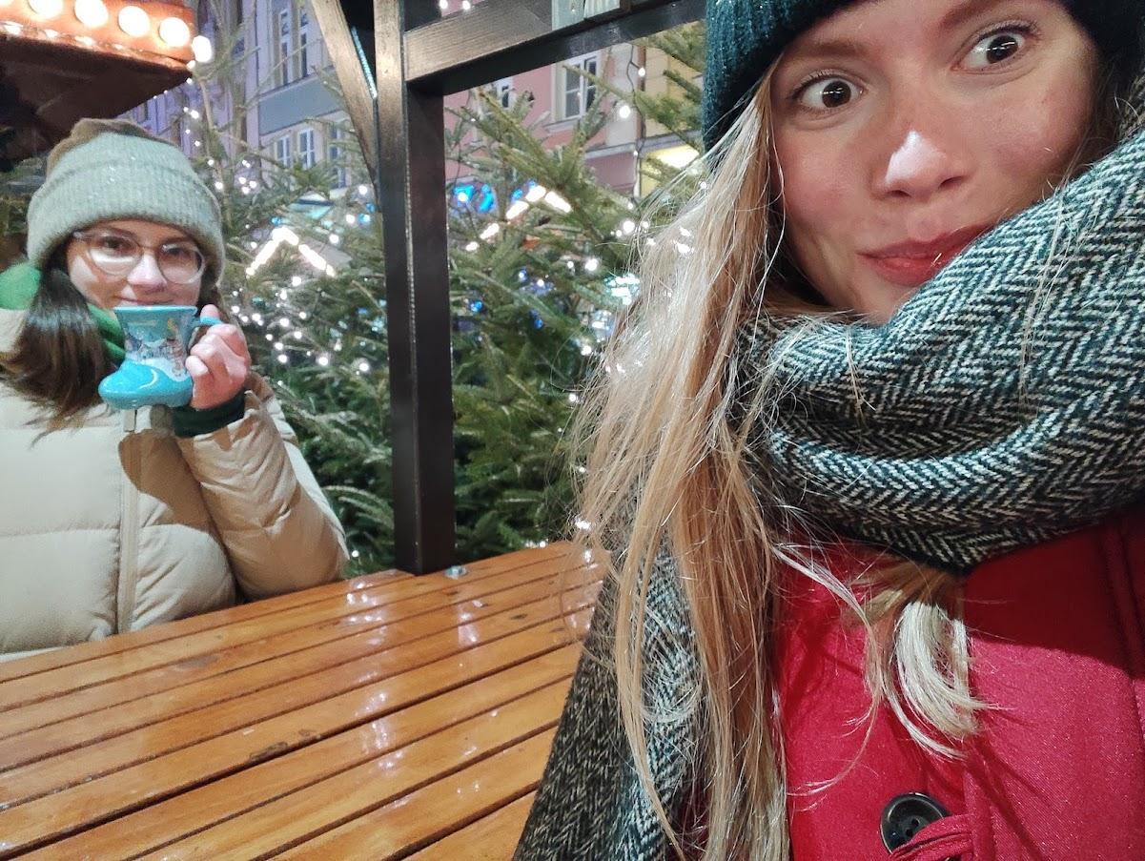
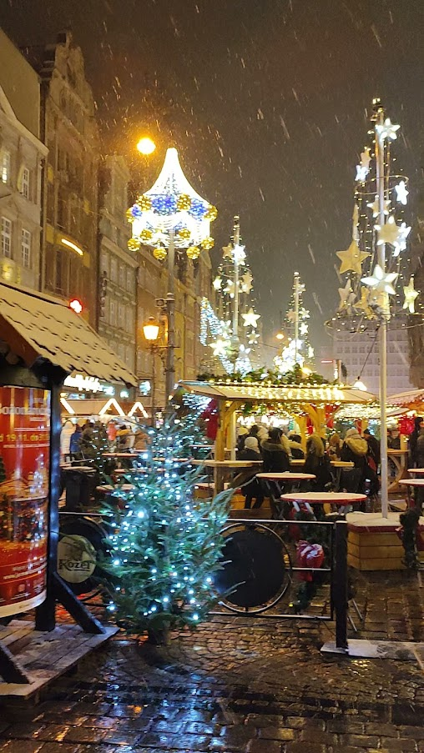
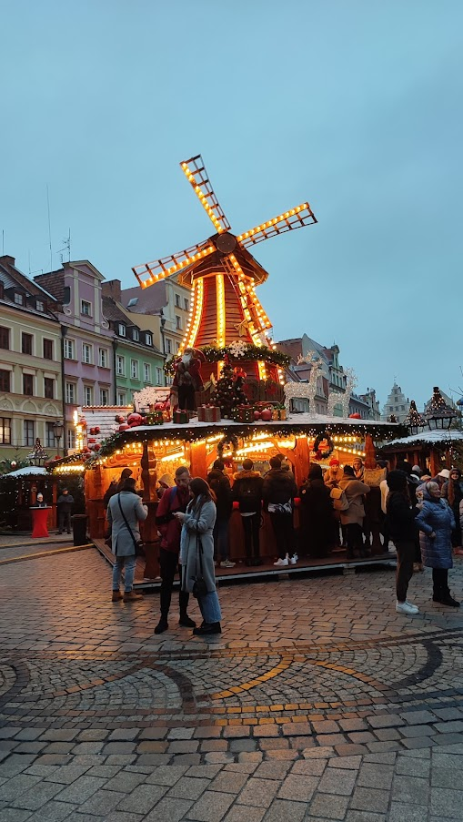
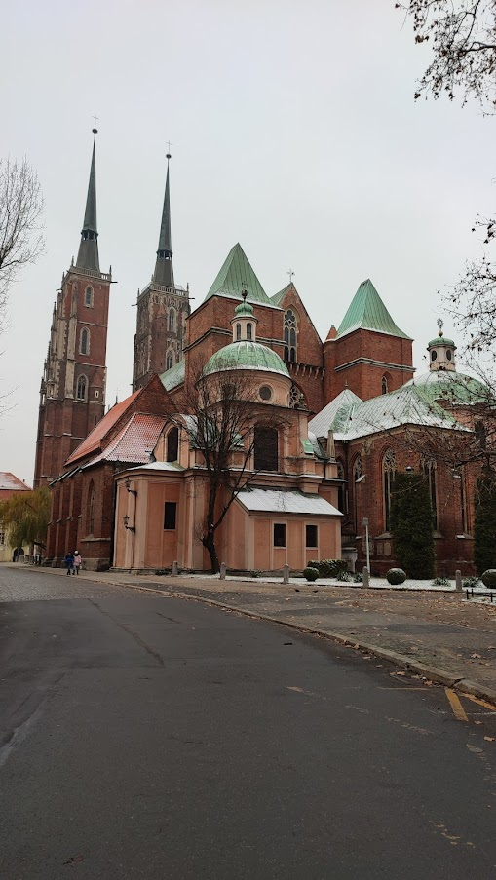
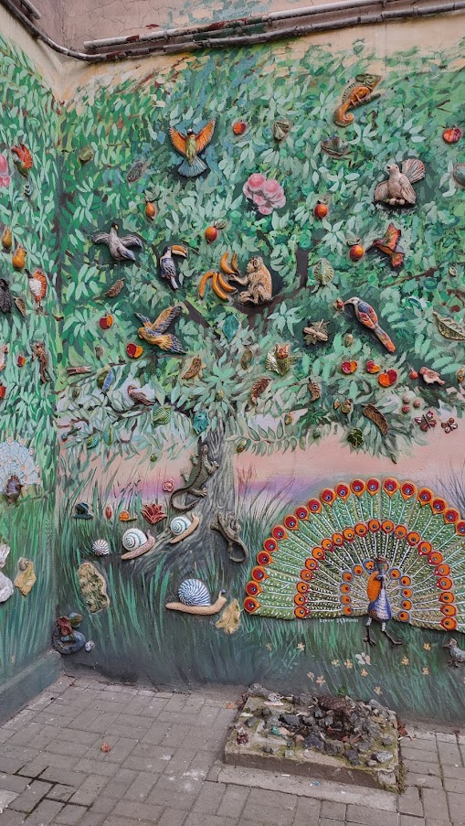
Wroclaw

Slide 16
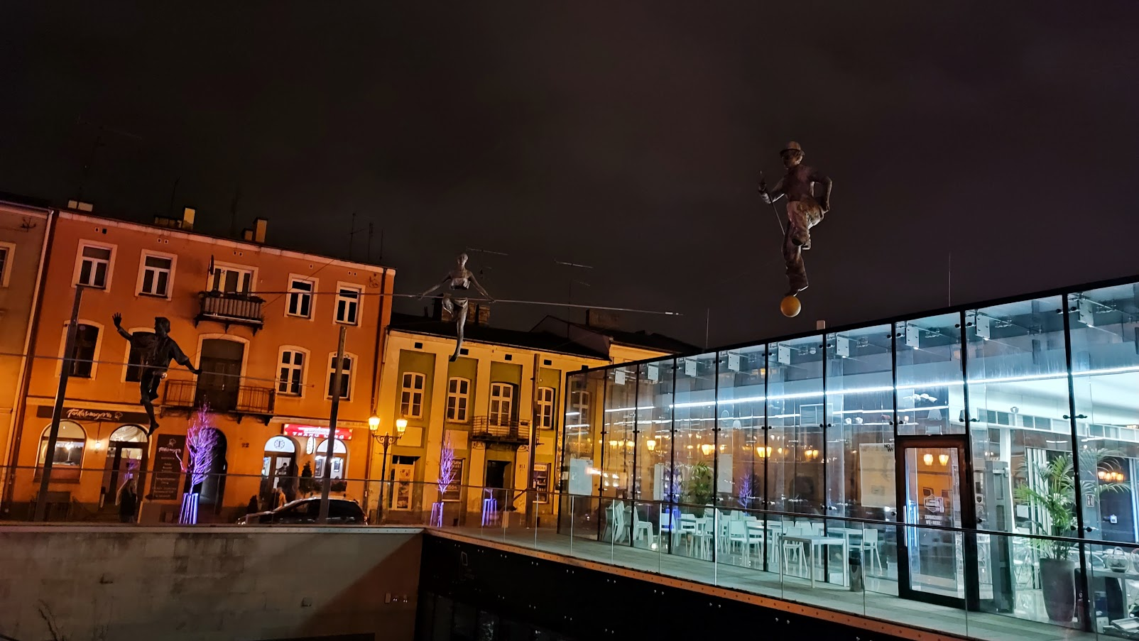
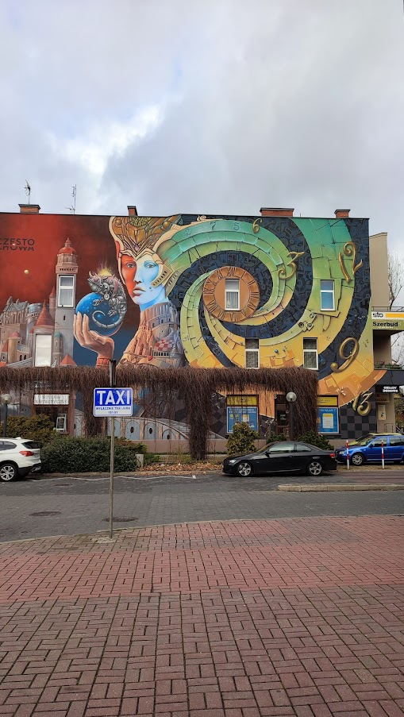
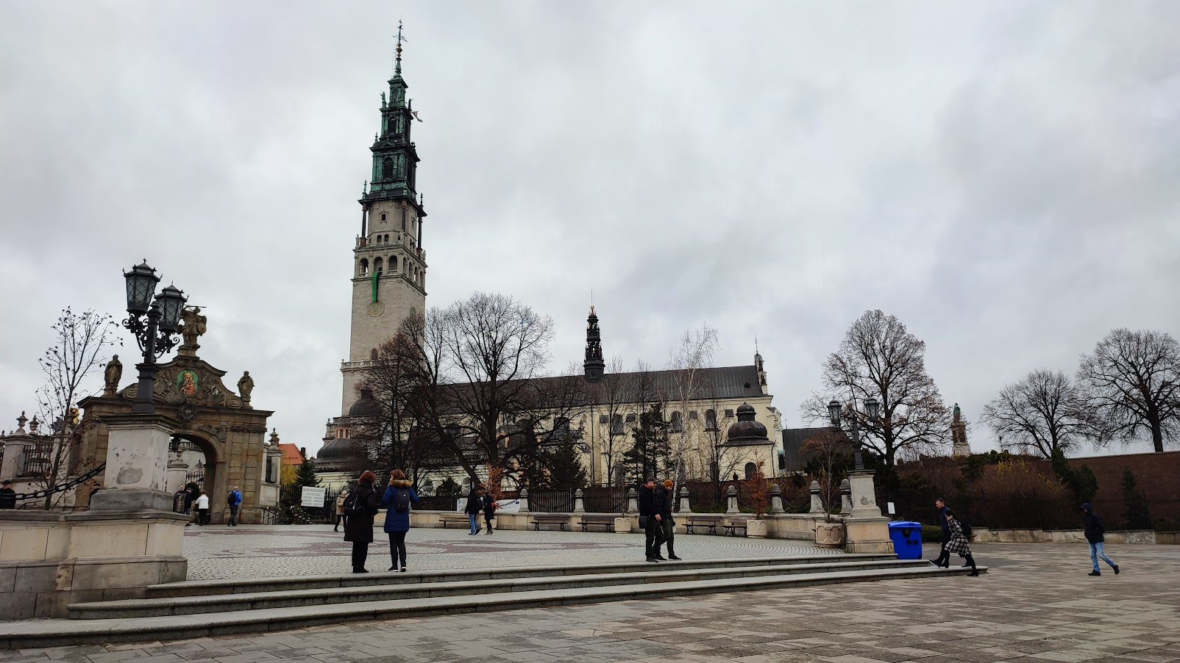
Czestochova

Slide 17
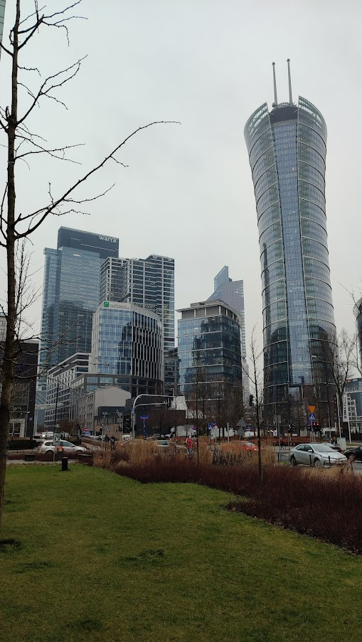
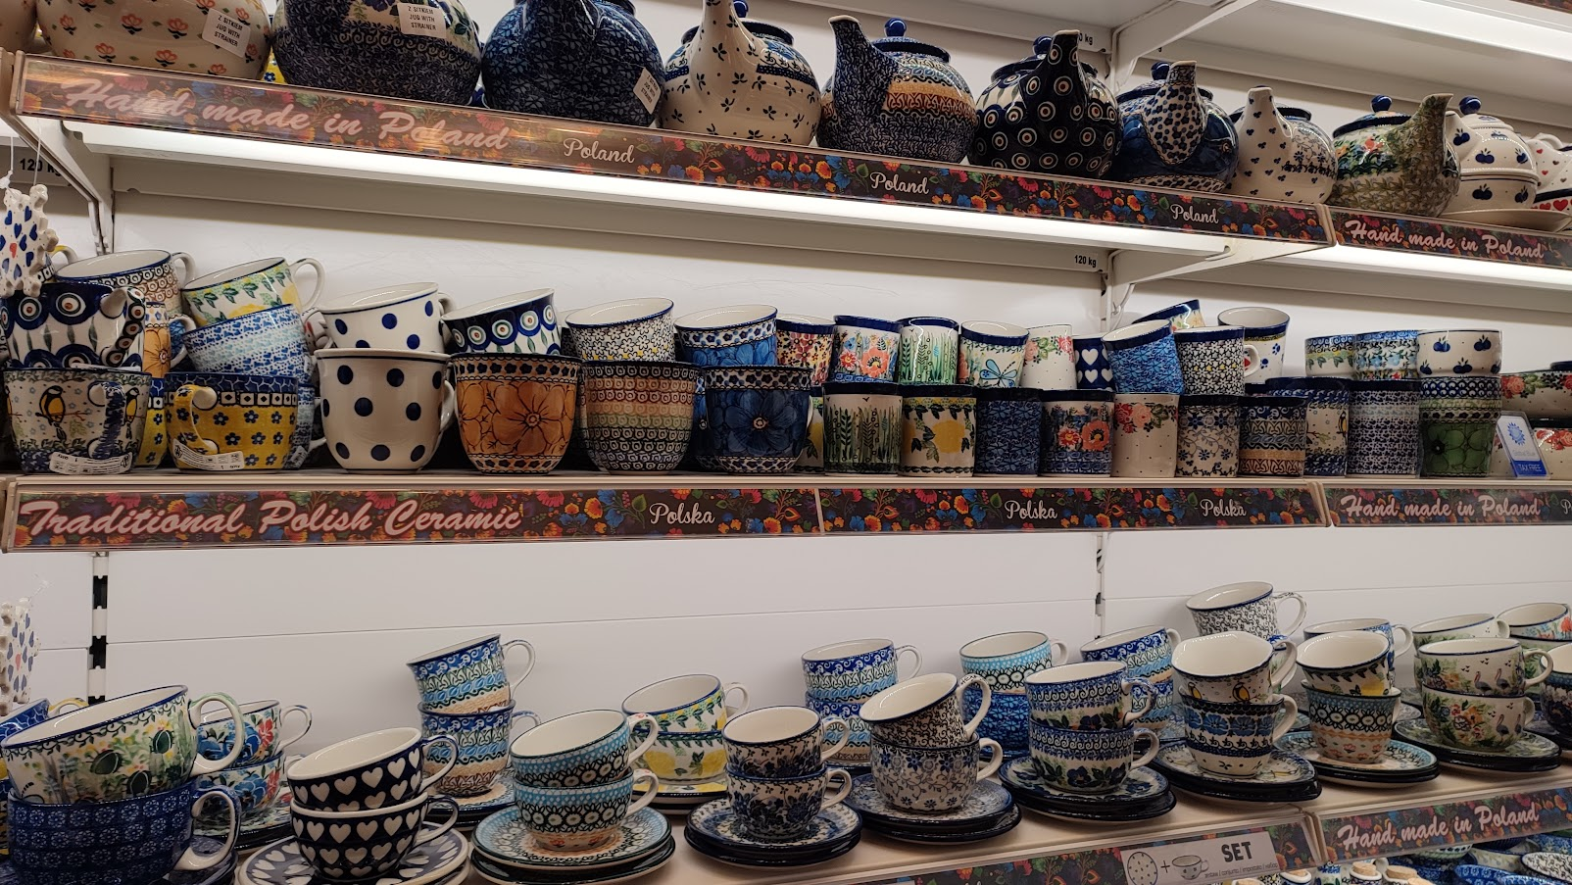
Warsaw

Slide 18
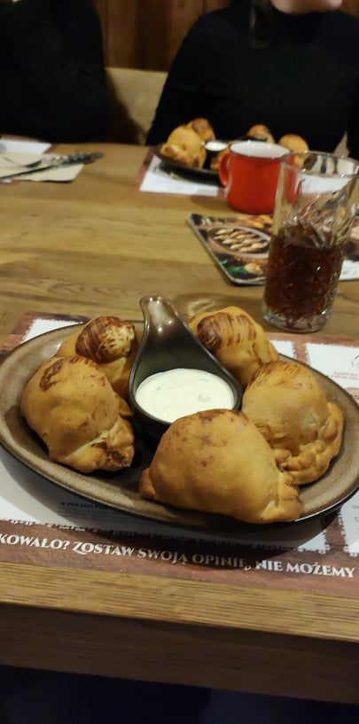
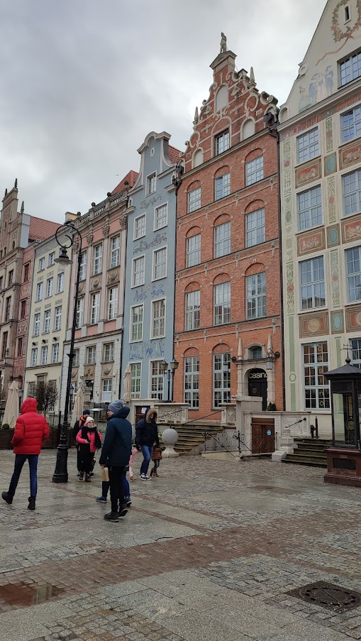
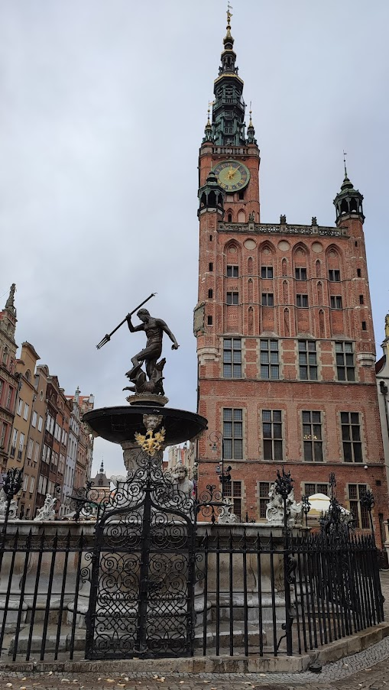
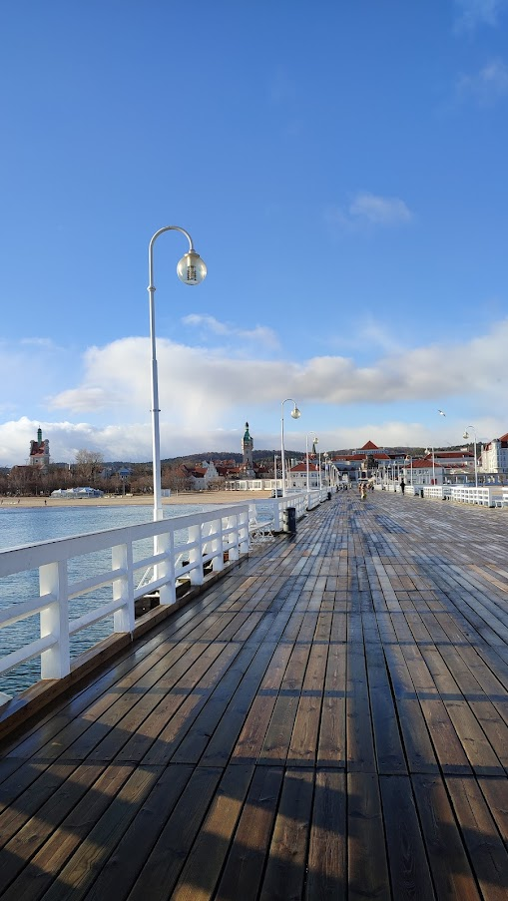
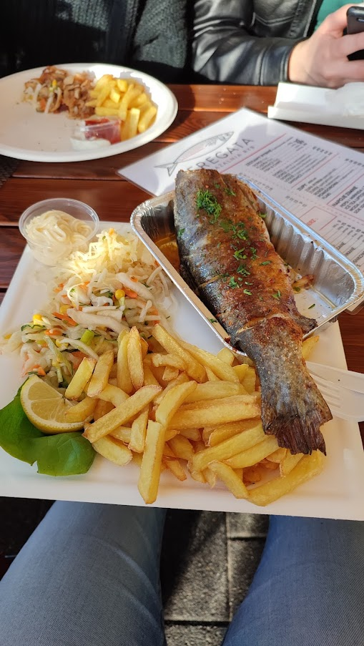
Gdansk, Sopot, Gdynia

Slide 19
Do you have any questions?
instagram: denisastavinohova
Facebook: Denisa Stavinohová

Slide 20
Thank you for your attention

