Slide 1
TOMAS BATA UNIVERSITY IN ZLÍN

Slide 2
UNIVERSITY – BRIEF SUMMARY
> young public higher education institution (law signed by Václav Havel)
> concept of an entrepreneurial university
> bilingual institution – educates graduates for the global market
> modern infrastructure

Slide 3
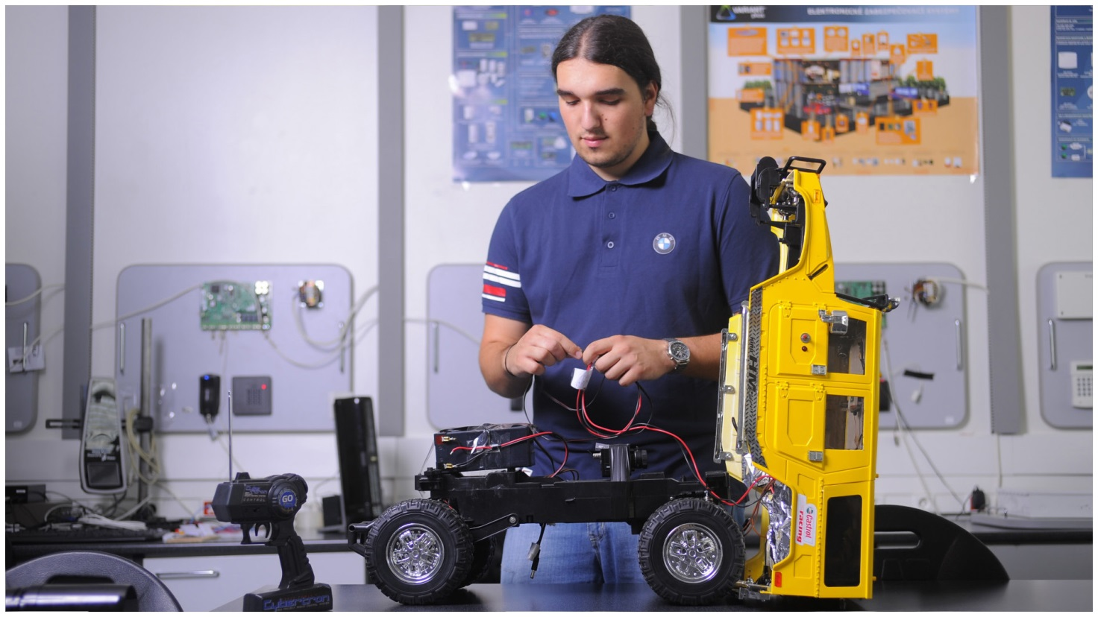
6 FACULTIES
+ UNIVERSITY INSTITUTE
211 DEGREE PROGRAMMES
out of which 66 in English
9,397 STUDENTS
out of which 1,032 international students
1,010 EMPLOYEES
out of which 516 academics

Slide 4
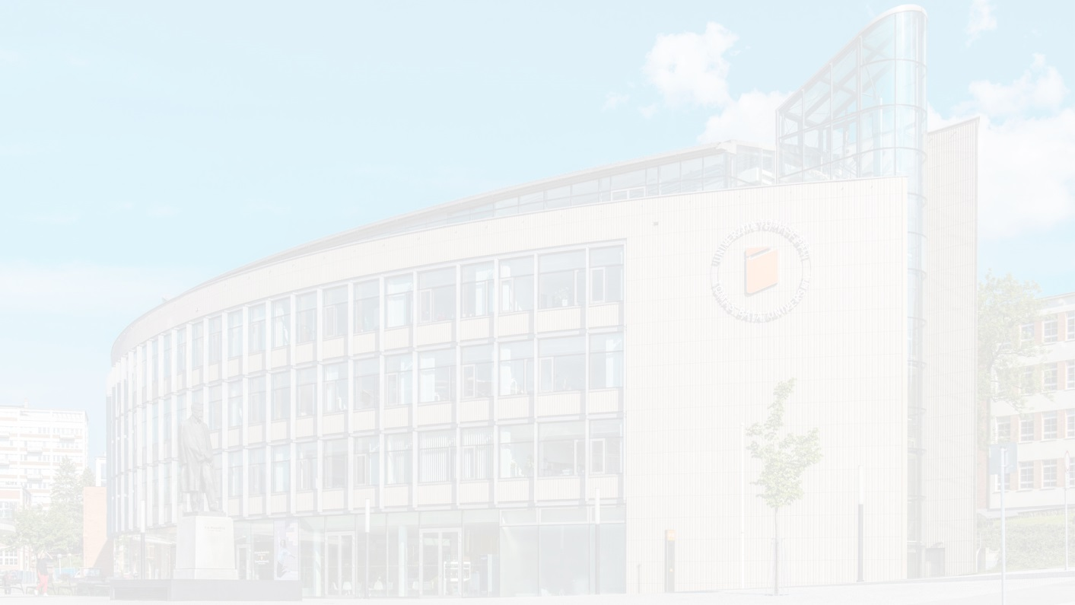
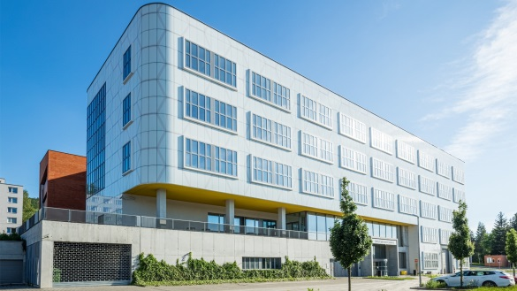
UNIVERSITY STRUCTURE EDUCATION AND RESEARCH UNITS
Faculty of Technology
Faculty of Management and Economics
Faculty of Multimedia Communications
University Institute
Polymer Centre
Centre of Applied Economic Research
Creative Centre UPPER
Centre of Polymer Systems
Technology Park
Technology Transfer Centre
Footwear Research Centre
Faculty of Humanities
Faculty of Applied Informatics
Faculty of Logistics and Crisis Management
Research Centre of FHS
ICT Scientific Research Park
CEBIA-Tech Research Centre

Slide 5
INTERNATIONAL RANKINGS
Times Higher Education World University Rankings 2019
(top 1258 HEIs from all around the world included in the ranking)
TBU ranked among TOP 40 universities founded after 2000
TBU ranked as the best Czech university in Business & Economics
QS University Rankings EECA 2020
Ranking of the top universities in Emerging Europe and Central Asia
(top 350 HEIs included in the ranking)
TBU Position: 85
CZ | World | University name
1 | 401-500 | Univerzita Tomáše Bati ve Zlíně
2 | 501+ | Vysoké učení technické v Brně
 | 501+ | Česká zemědělská univerzita v Praze
 | 501+ | Vysoká škola ekonomická v Praze
 | 501+ | Masarykova univerzita
 | 501+ | Technická univerzita Liberec
 | 501+ | VŠB – Technická univerzita Ostrava

Slide 6
FACULTIES

Slide 7
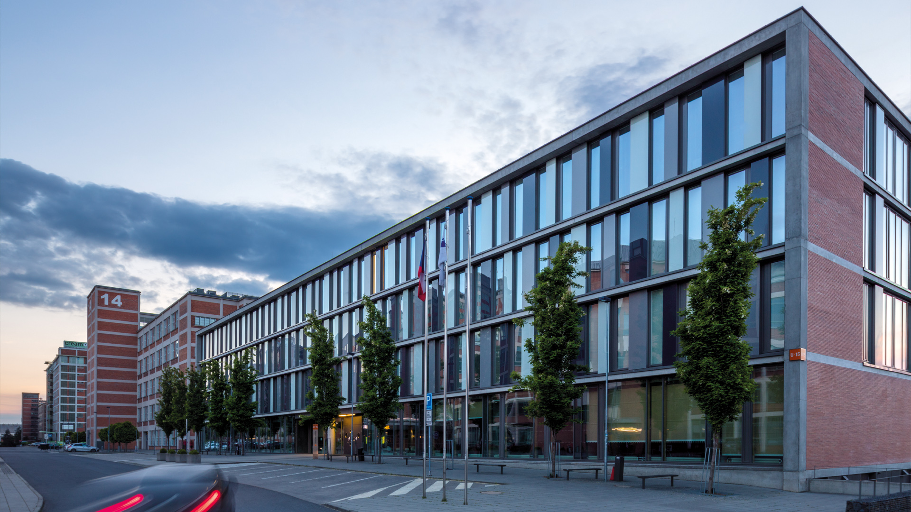
FACULTY OF TECHNOLOGY
> founded in 1969
> 1,664 students

Slide 8
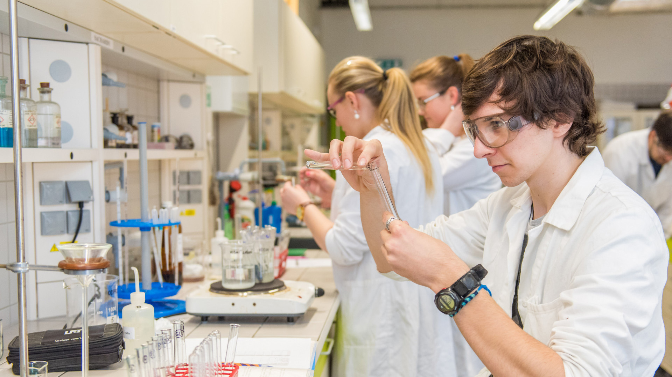
FACULTY OF TECHNOLOGY
> polymer materials and engineering, food analysis and chemistry, food technology,
physics, materials engineering, production engineering, chemistry, environmental
protection engineering, fat & surfactant & cosmetics technology

Slide 9
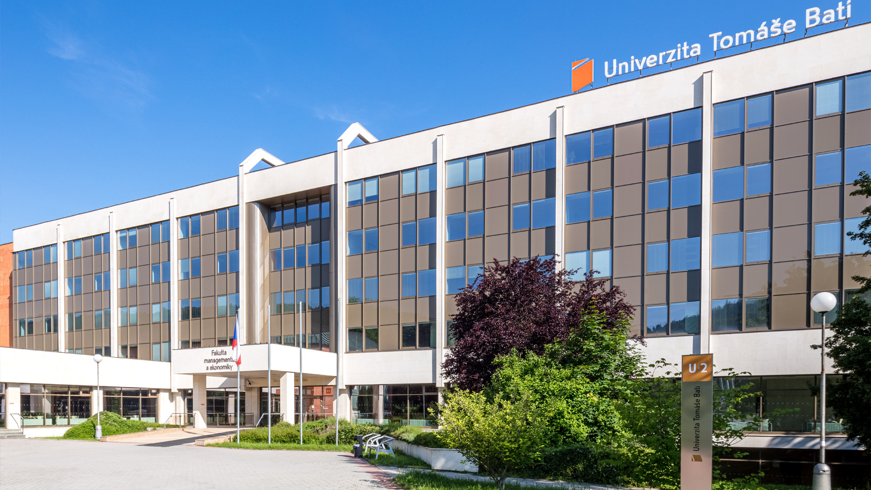
FACULTY OF MANAGEMENT AND ECONOMICS
> founded in 1995
> 2,097 students

Slide 10
FACULTY OF MANAGEMENT AND ECONOMICS
> management, marketing, economics, finance, accounting, industrial engineering
and information systems, enterprise economics, statistics and quantitative
methods, regional development, public sector, law, physical training

Slide 11
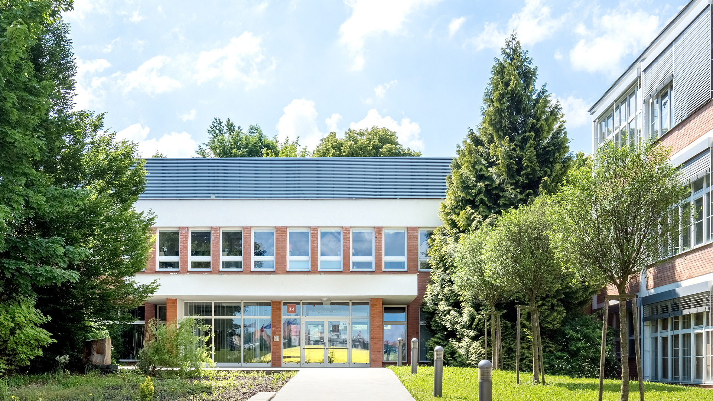
FACULTY OF MULTIMEDIA COMMUNICATIONS
> founded in 2002
> 1,159 students

Slide 12
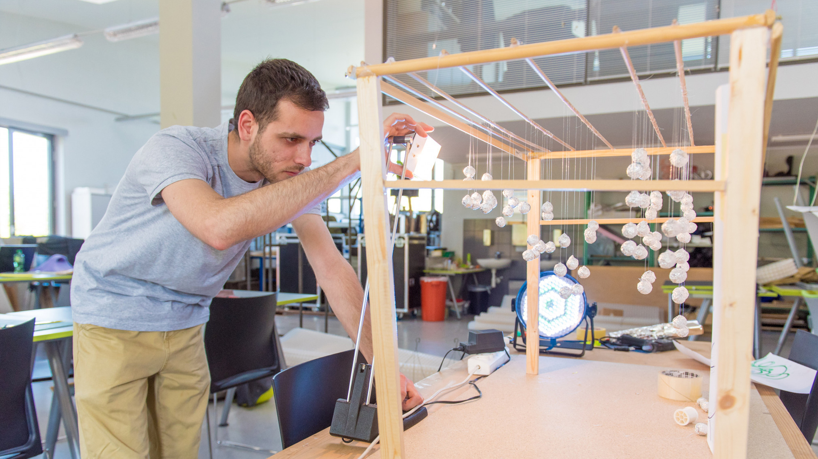
FACULTY OF MULTIMEDIA COMMUNICATIONS
> marketing & communications, animation, audiovisual arts, shoe design, fashion
design, glass design, digital design, graphic design, product design, spatial
design, industrial design, advertising photography, theoretical studies

Slide 13
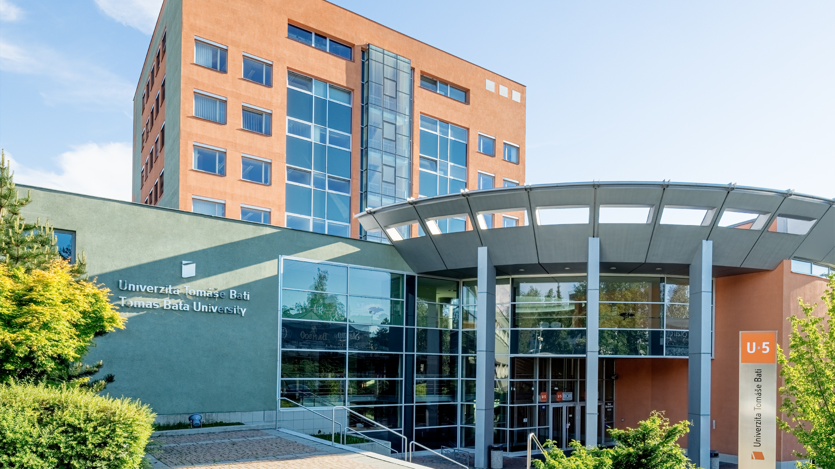
FACULTY OF APPLIED INFORMATICS
> founded in 2006
> 1,446 students

Slide 14
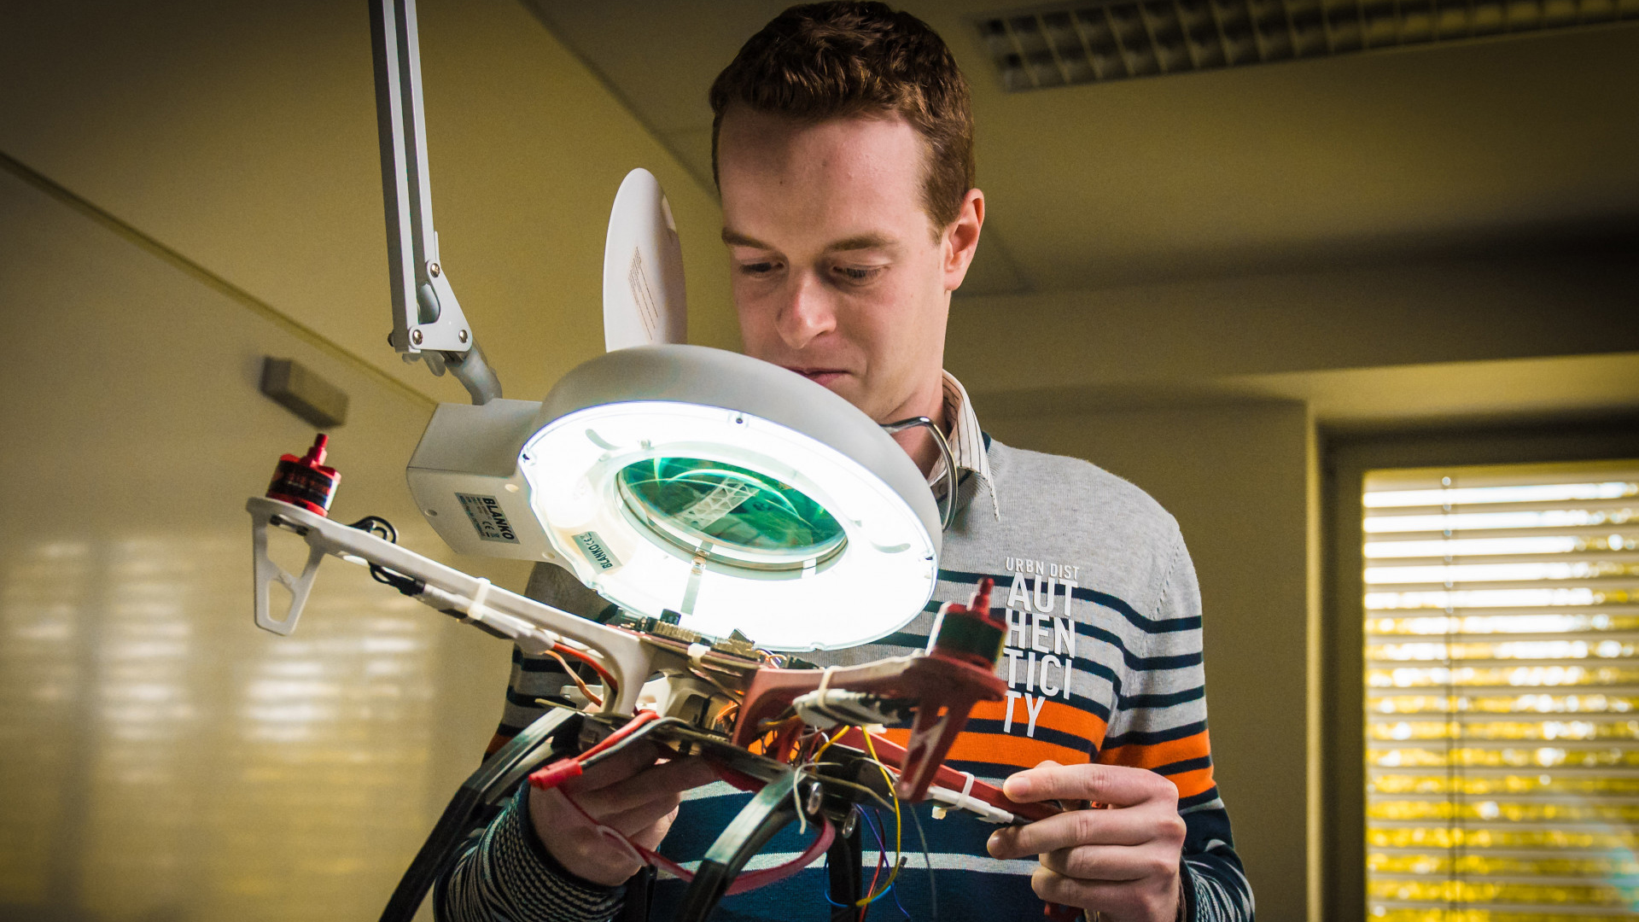
FACULTY OF APPLIED INFORMATICS
> informatics, artificial intelligence, computer & communication systems, automation
and control engineering, electronics and measurements, security engineering,
mathematics, process control, security systems, intelligent houses

Slide 15
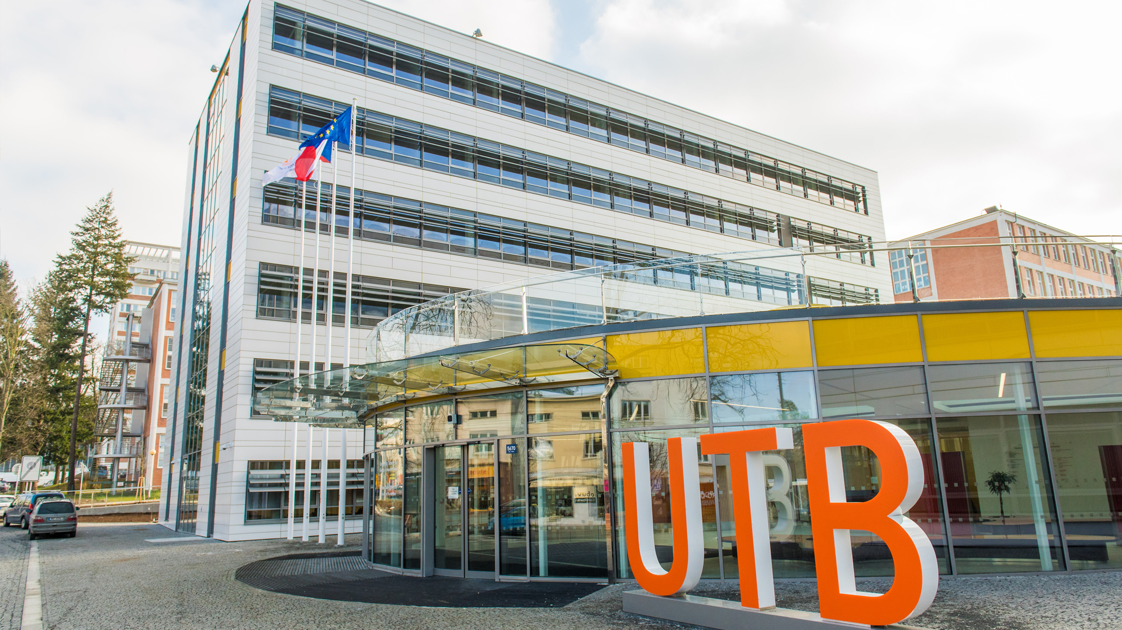
FACULTY OF HUMANITIES
> founded in 2007
> 1,967 students

Slide 16
FACULTY OF HUMANITIES
> pedagogical sciences, school education, modern languages and literatures,
health care sciences

Slide 17
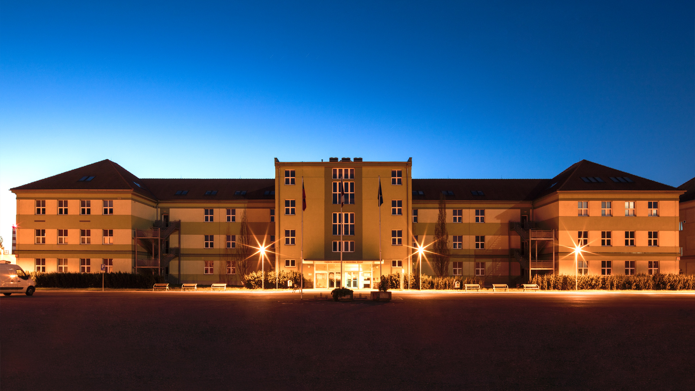
FACULTY OF LOGISTICS AND CRISIS MANAGEMENT
> founded in 2009
> applied logistics, crisis management, environmental security,
population protection, risk control
> 859 students

Slide 18
RESEARCH
AND DEVELOPMENT

Slide 19
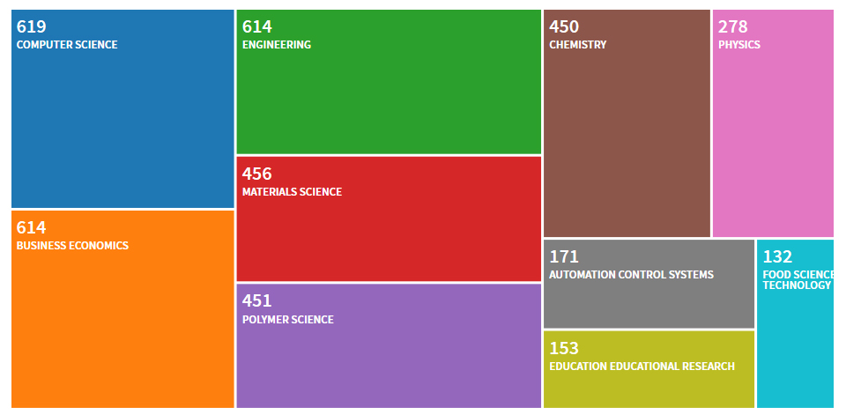
SCIENTIFIC DISCIPLINES (THE WEB OF SCIENCE)
Number of publications from 2001 to 2018, TOP 10 scientific disciplines

Slide 20
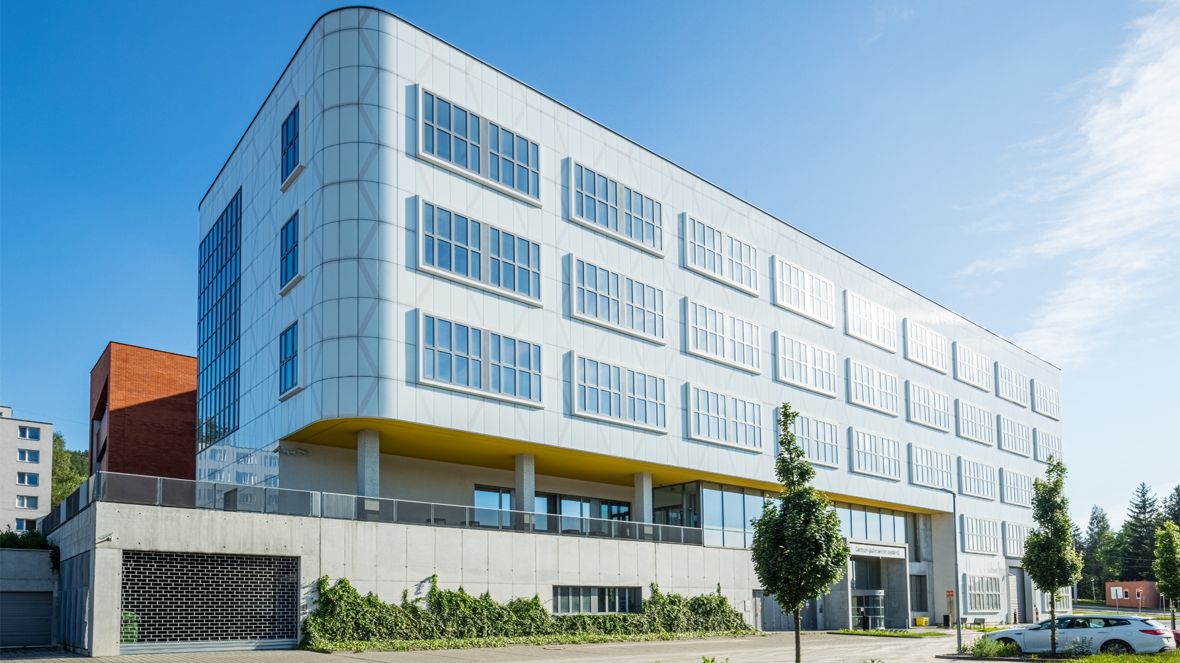
CENTRE OF POLYMER SYSTEMS

Slide 21
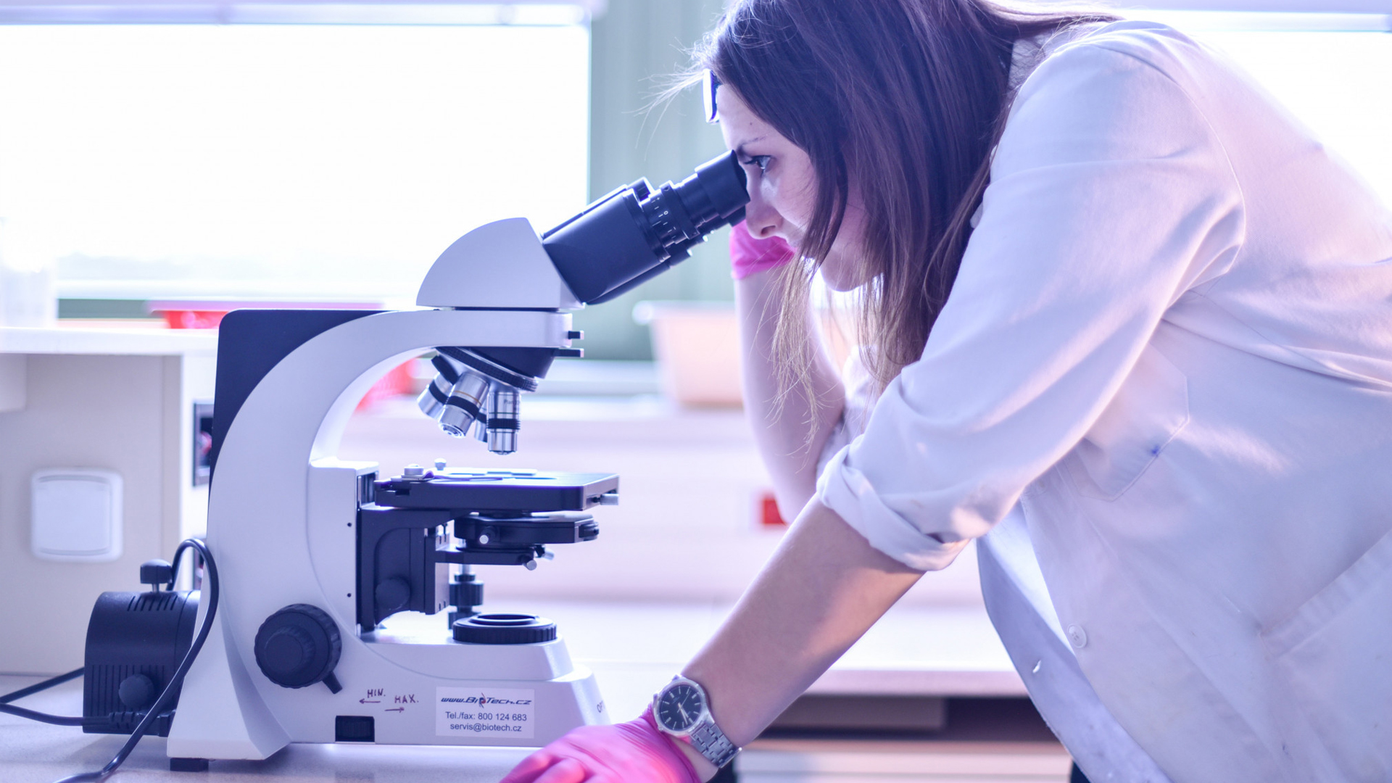
CENTRE OF POLYMER SYSTEMS
RESEARCH FIELDS
> Processing of plastics
> Bioactive polymer systems
> Surface treatment of materials
> Rubber processing and materials
> Multifunctional nanomaterials
> Systems with senzoric properties
> Composites with electric and magnetic
properties
> Biocomposite systems

Slide 22
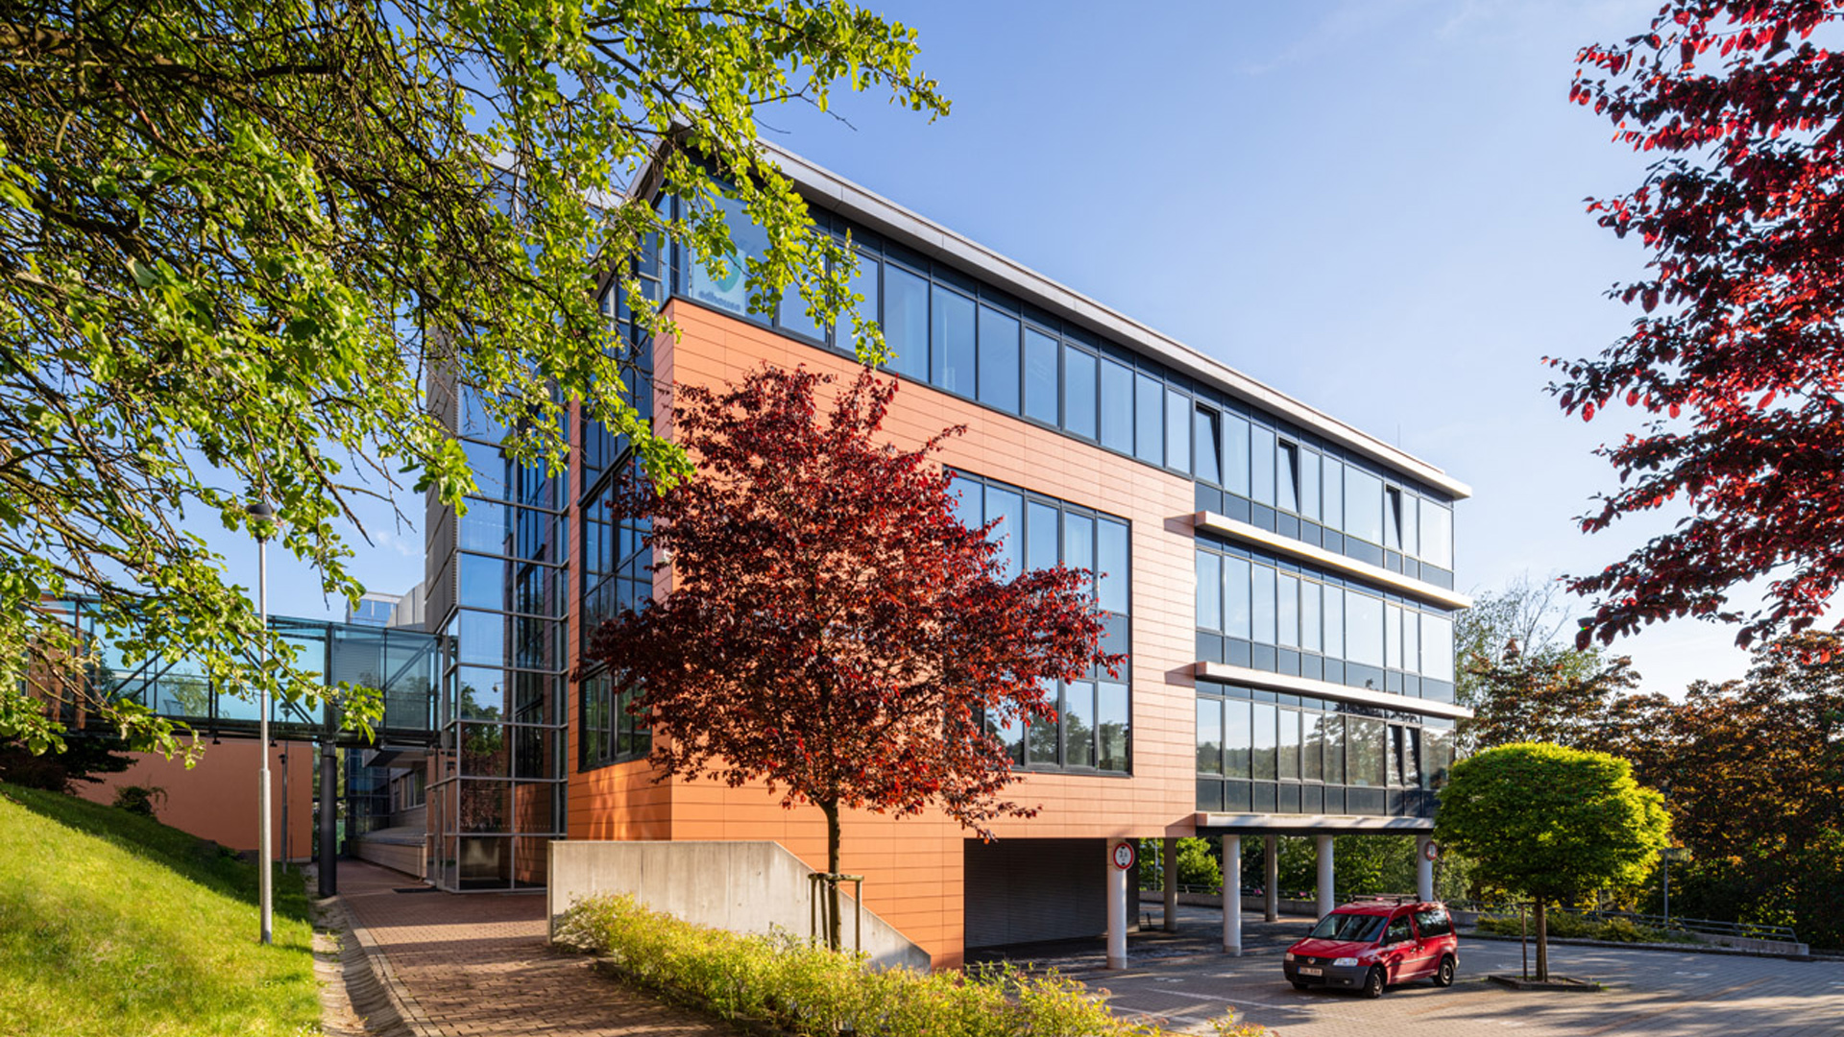
CENTRE FOR SECURITY, INFORMATION AND ADVANCED TECHNOLOGIES

Slide 23
CENTRE FOR SECURITY, INFORMATION AND ADVANCED TECHNOLOGIES
RESEARCH FIELDS
> Grid Computing and the application of Artificial Intelligence methods
> Intelligent Production Systems
> Smart Buildings
> Embedded Systems
> Small mobile data and telecommunication networks for rapid-deployment units
> System for the detection and analysis of hazardous substances using THz frequencies
> The development of technical procedures for the protection of electronic systems against internal and external electromagnetic field interference
> Alternative Energy Resources – Biofuels

Slide 24
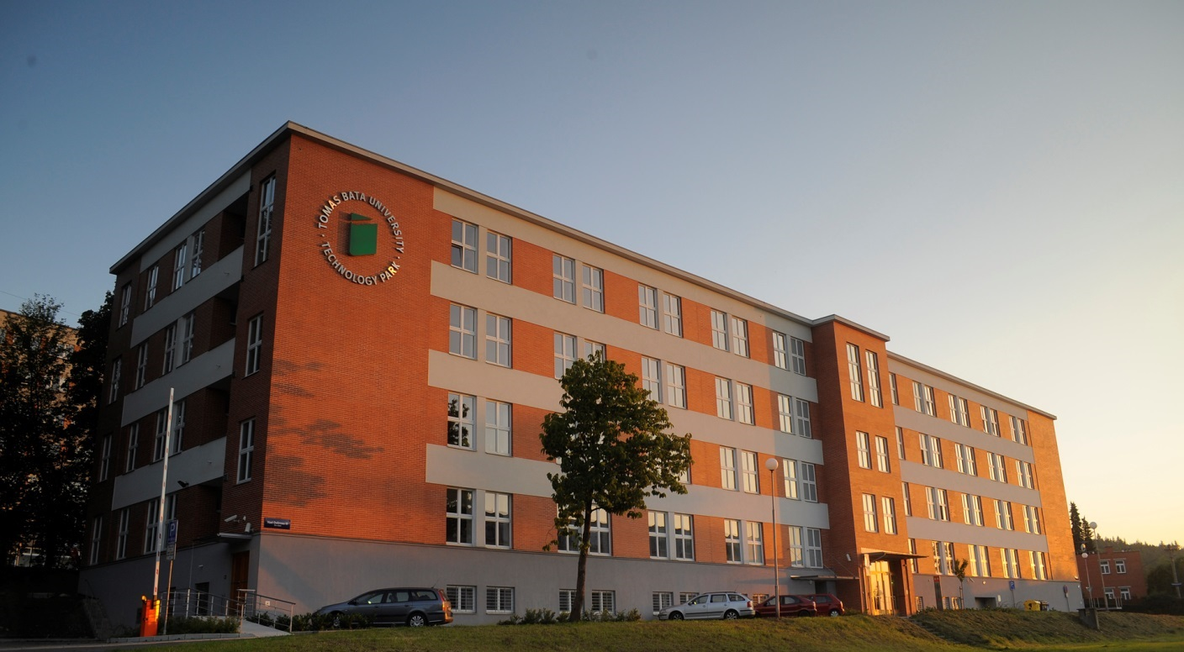
TECHNOLOGY TRANSFER
146 patent applications
157 utility model applications
90 industrial design applications
22 trademark applications
75 patents granted
152 registered utility models
90 registered industrial designs
20 registered trademarks

Slide 25
INTERNATIONALIZATION

Slide 26
INTERNATIONALIZATION
> cooperation with universities from 67 countries
> 500+ partner institutions all over the world
> there are 1,032 international students studying at TBU
> 500 international students study at TBU every year within mobility programmes
> summer schools are organized every year
> Buddy System Zlín - organization of trips, events and other activities

Slide 27
MOTTO
„Europe is not our only target. We must be able to produce graduates for the global market!“
Tomáš Baťa jr.

Slide 28
THANK YOU
FOR YOUR ATTENTION
www.utb.cz

