Slide 1
Faculty of Humanities

Slide 2
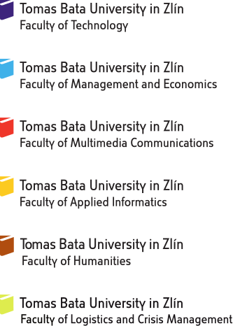
Structure of Tomas Bata University

Slide 3
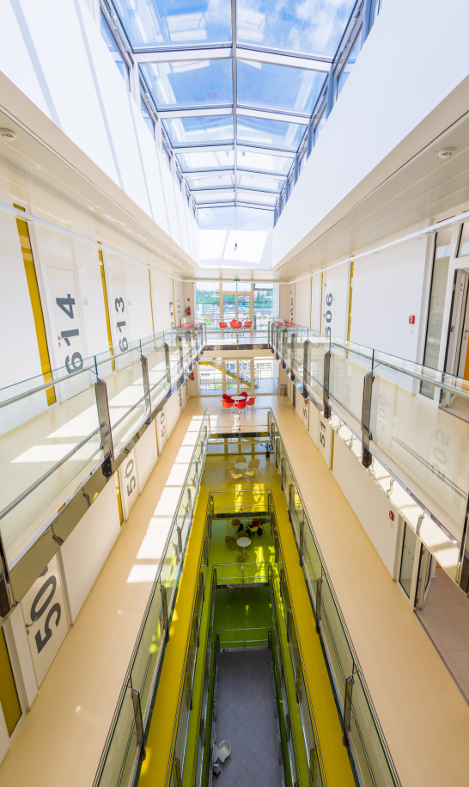
Departments and Centres
Established on 1 January 2007
Department of Modern Languages and Literatures
Language Centre
Department of Pedagogical Sciences
Department of School Education
Department of Health Care Sciences
Research Centre of FHS

Slide 4
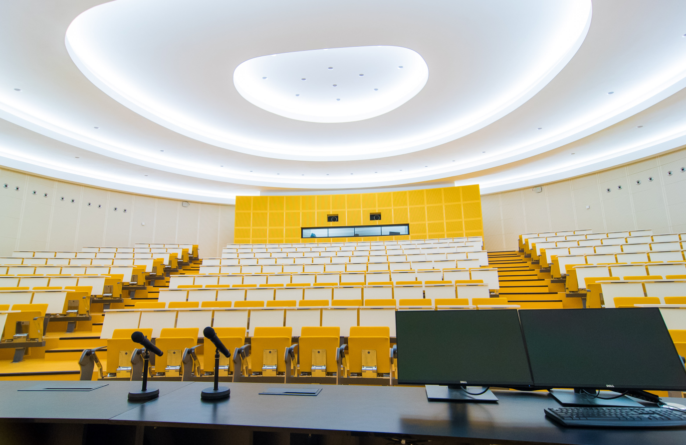
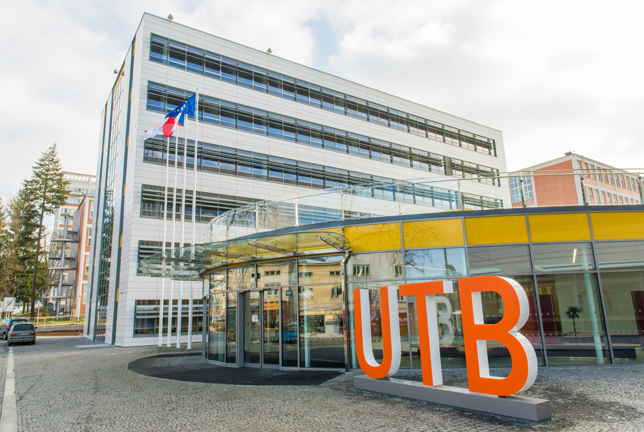
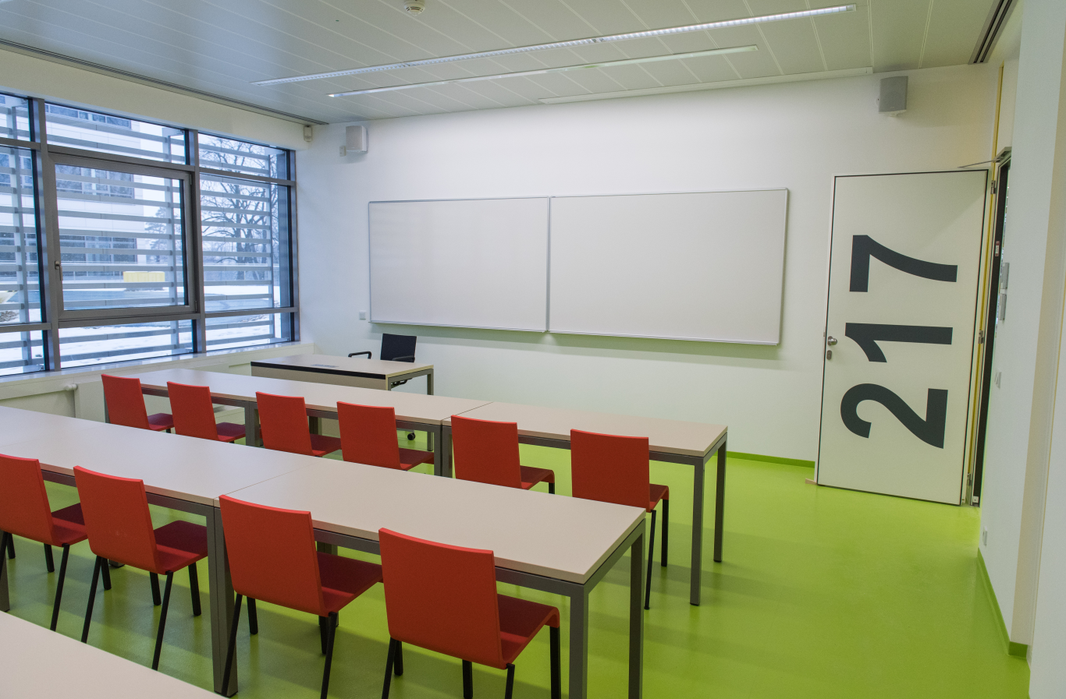
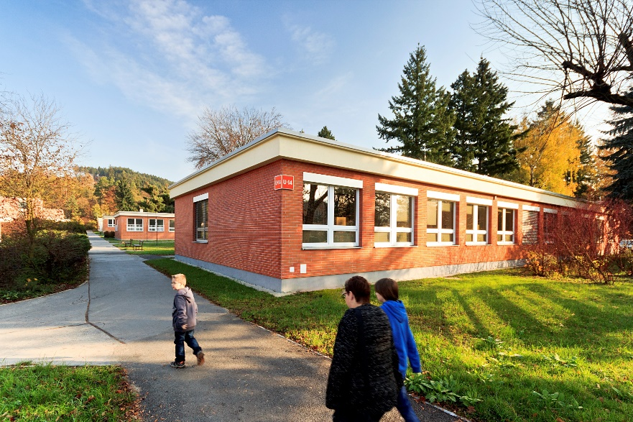
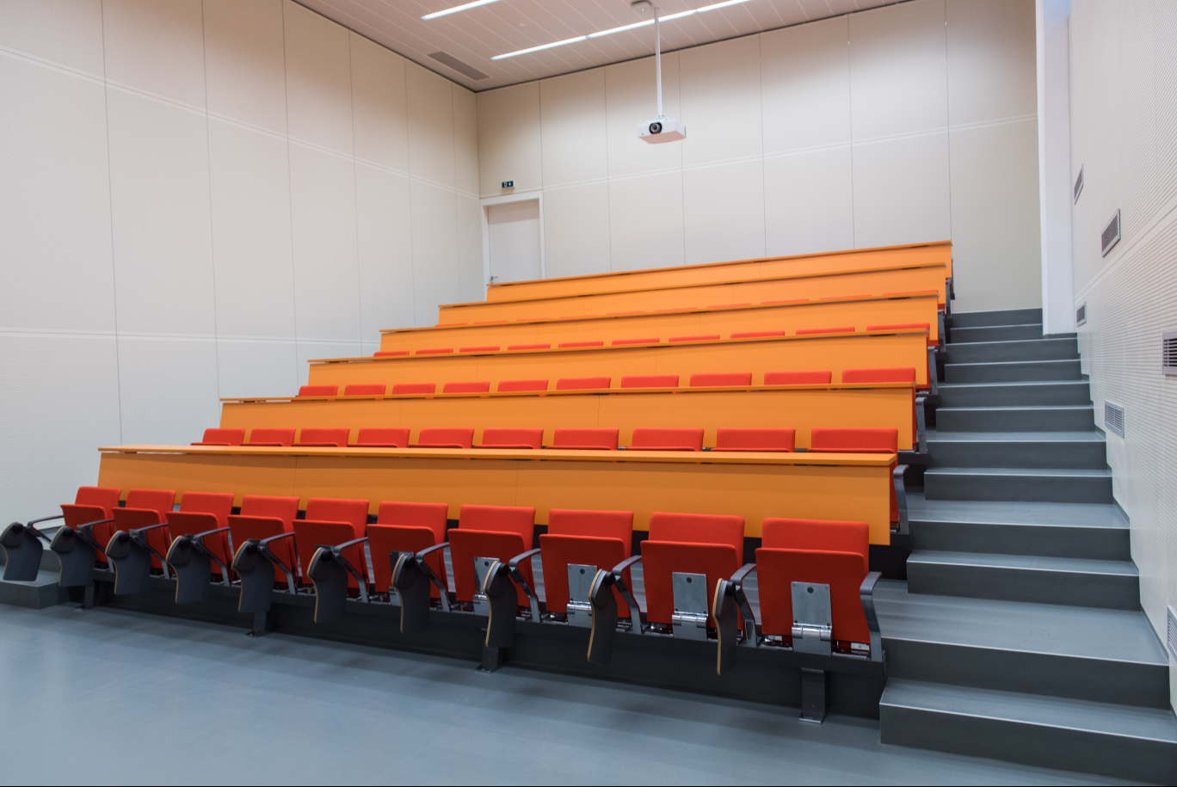
Faculty Campus
Promotional video: https://www.youtube.com/watch?v=dAHvFZnvag8
Virtual Tour: https://www.utb.cz/vp/

Slide 5
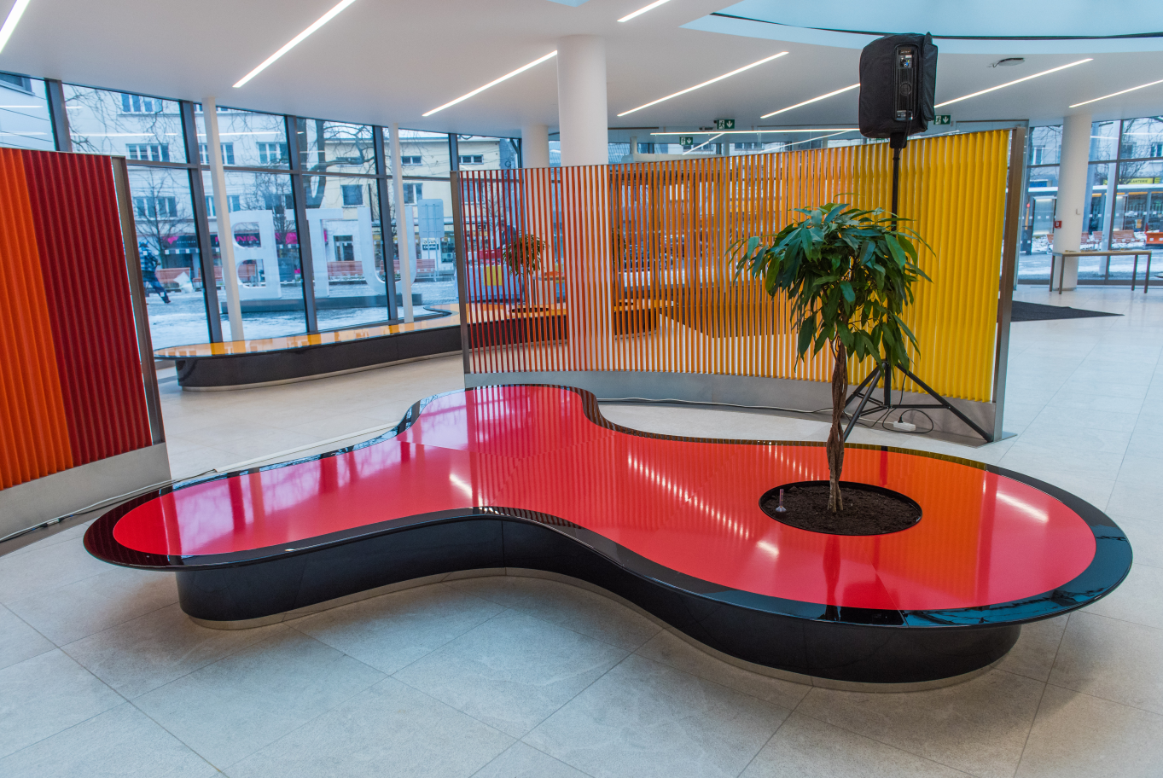
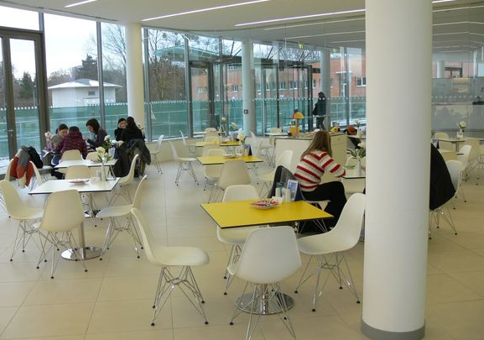
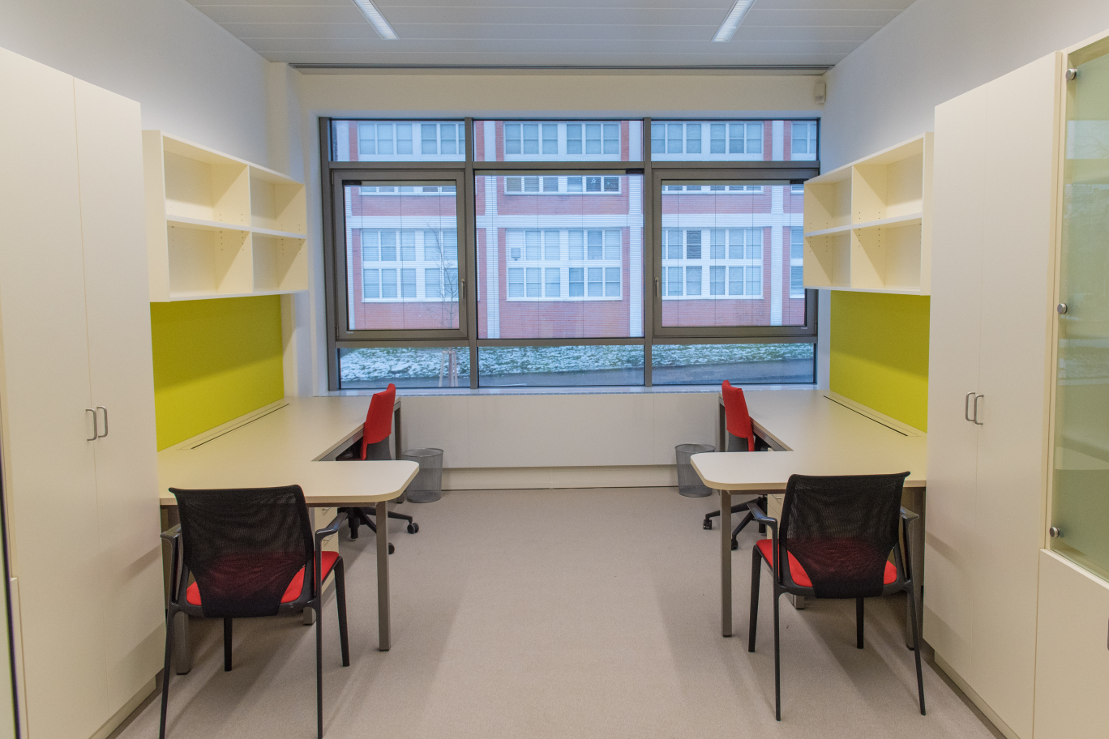
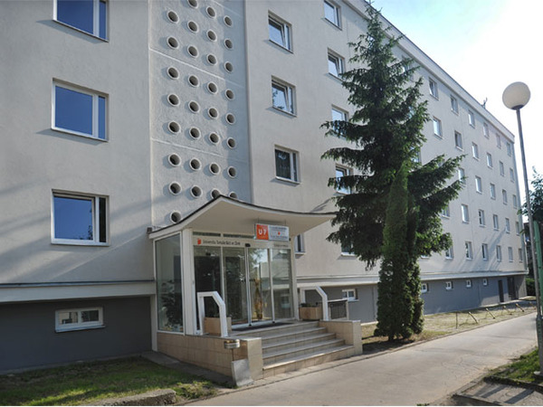
Modern
Facilities

Slide 6
Study at FHS
Study Cycles
Bachelor
Master
Doctoral
Fields of Study
Foreign Languages
Pedagogical Sciences
School Education
Heath Care Sciences

Slide 7
Philology
English for Business Administration
German for Business Administration

Slide 8
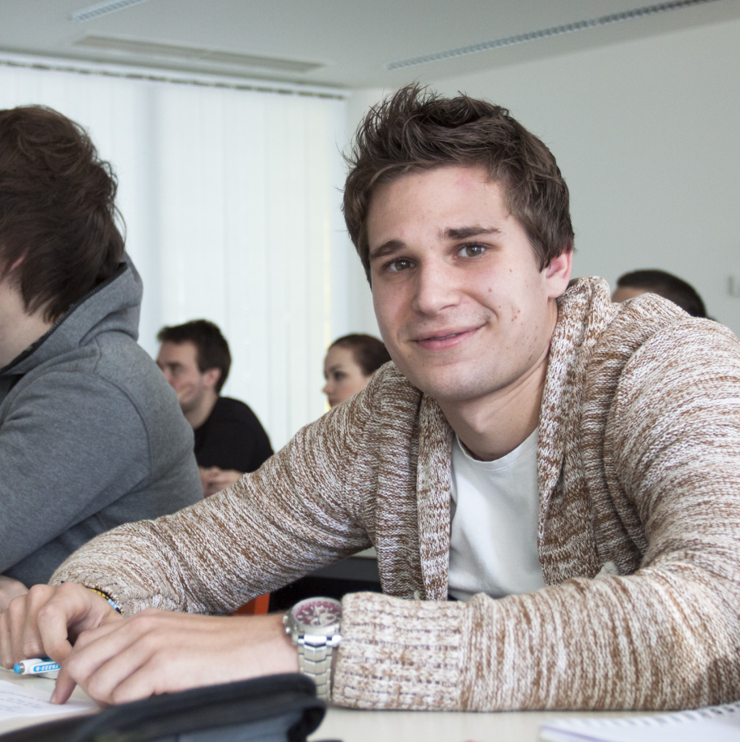
Specialization in Pedagogy
Social Pedagogy
Andragogy for Human Resource Management in Non-Profit Organizations
Education
Kindergarten Teaching
Primary School Teaching
Teaching Specialist Subjects in Secondary Schools

Slide 9
Nursing
Nurse
Health and Social Care
Health and Social Care Worker
Midwifery
Midwife

Slide 10
Exchange programmes in English
No tuition fee
1 – 2 semesters
Subject selection
English Philology
German Philology (taught in German)
Education
Social Pedagogy,
Nursing (incl. traineeship)
Health and Social Care
Midwifery (incl. traineeship)

Slide 11
Research
Self-regulated learning and behaviour
Multicultural competences
Teachers' self-efficacy
Anglophone literature
Stereotypes and strategies in discourse
Status of the German language and culture in Central Europe
The issue of hospice and palliative care focused on a non-terminal and terminal stage of the disease
Health and social care
Lifestyle and reproductive health of fertile population

Slide 12
Practical information
Accommodation
Cost of living
All International students are usually staying in University Halls of Residence (3 buildings in the centre of Zlín). The price is approx. CZK 3 000/month (116 EUR).
Students who would like to arrange their accommodation outside the TBU Halls of Residence have to contact real-estate agencies in Zlín. Students who arrange an off-campus accommodation are obliged to inform the Department for Asylum and Migration Policy and the TBU International Office about it.
Student needs 300 – 400 EUR per month to cover the basic costs, such as catering, accommodation and transport.
At a restaurant the average price of a meal is around 4,70 EUR, in the student canteen the price is 2 EUR.
Monthly public transport ticket for students over 26 is 7,50 EUR.
One way ticket to Prague (by train) costs 10,80 EUR.

Slide 13
Practical information
Health Insurance
Getting to Zlín
All International students must have health insurance coverage for illness, accidents, etc. for the entire period of their stay.
A „pick up service“ might be organized for all incoming students.
The air gate to the Czech Republic is the Václav Havel Airport Prague. There are a lot of bus/train connections from Prague to Zlín. Another possibility is to fly to Vienna (Austria) – 220 km from Zlín or Bratislava (Slovakia) – 200 km from Zlín.

Slide 14
Contacts
Tomas Bata University
International Office:
Email: international@utb.cz
Faculty of Humanities
Coordinator for External Relations:
Email: vnejsi-vztahy@fhs.utb.cz
Website: www.utb.cz

